Slide 1
August 23, 2021 | Portland, me
New England’s Changing Resource Mix and Challenges for Power System Operations in Extreme Weather Conditions
Northeast Public Power Association 2021 Annual Conference
Gordon van Welie
President & CEO

Slide 2
ISO New England’s Mission and Vision
Mission: What we do
Through collaboration and innovation, ISO New England plans the transmission system, administers the region’s wholesale markets, and operates the power system to ensure reliable and competitively priced wholesale electricity
Vision: Where we’re going
To harness the power of competition and advanced technologies to reliably plan and operate the grid as the region transitions to clean energy
The ISO’s new Vision for the future represents our long-term intent and guides the formulation of our Strategic Goals

Slide 3
Key Regional Themes
Opportunities and Challenges: The Clean Energy Transition is creating opportunities and challenges for the region’s bulk power system
Extensive Analysis Underway: ISO New England is studying the reliability of a future grid under a range of scenarios
This will help the ISO and stakeholders understand the implications for operations, transmission planning, and market design

Slide 4
Key Regional Themes, cont.
Managing Risk: Existing reliability risks during extreme weather will be amplified by increasing restrictions on carbon emissions and a prevalence of limited-energy resources (gas/renewables)
There are limits to how much risk can be mitigated through the market
New England can learn from extreme weather events in other regions
Transmission Expansion: More transmission will be needed to interconnect and deliver large-scale renewable energy to meet state policy goals (separate from reliability needs)
Adapting the Market Design: Wholesale electricity markets are adapting to changing circumstances and policy objectives

Slide 5
Achieving state policy goals will fundamentally change the resource mix
This will ultimately affect the entire economy as states seek to use clean energy from the grid to electrify the heating and transportation sectors

Slide 6
New England’s Power System Has Already Experienced Dramatic Changes in the Energy Mix Economic and environmental factors have shifted the region’s electricity production
Percent of Total Electric Energy Production by Fuel Type (2000 vs. 2020)
Source: ISO New England Net Energy and Peak Load by Source; data for 2020 is preliminary and subject to resettlement
Renewables include landfill gas, biomass, other biomass gas, wind, grid-scale solar, municipal solid waste, and miscellaneous fuels. This data represents electric generation within New England; it does not include imports or behind-the-meter (BTM) resources, such as BTM solar.

Slide 7
States Are Targeting Increases in Renewable and Clean Energy and Deep Reductions in CO₂ Emissions
≥80% by 2050 | Five states mandate greenhouse gas reductions economy wide: MA, CT, ME, RI, and VT (mostly below 1990 levels)
Net-Zero by 2050 80% by 2050 | MA statewide GHG emissions limit MA clean energy standard
90% by 2050 | VT renewable energy requirement
100% by 2050 Carbon-Neutral by 2045 | ME renewable energy requirement ME emissions goal
100% by 2040 | CT zero-carbon electricity goal
100% by 2030 | RI renewable energy goal

Slide 8
State Polices are Requiring Increasing Amounts of Renewable Energy
ME
VT: 2020 – 59%
2025 – 63%
2030 – 71%
2035 – 75%
2040 – 75%
MA
CT
RI
NH
Notes: State RPS requirements promote the development of renewable energy resources by requiring electricity providers (electric distribution companies and competitive suppliers) to serve a minimum percentage of their retail load using renewable energy. Connecticut’s Class I RPS requirement plateaus at 40% in 2030. Maine’s Class I/IA RPS requirement increases to 50% in 2030 and remains at that level each year thereafter. Massachusetts’ Class I RPS requirement increases by 2% each year between 2020 and 2024, 3% each year between 2025 and 2029, reverting back to 1% each year thereafter, with no stated expiration date. New Hampshire’s percentages include the requirements for both Class I and Class II resources (Class II resources are new solar technologies beginning operation after January 1, 2006). New Hampshire’s Class I and Class II RPS requirements plateau at 15.7% in 2025. Rhode Island’s requirement for ‘new’ renewable energy plateaus at 36.5% in 2035. Vermont’s ‘total renewable energy’ requirement plateaus at 75% in 2032; it recognizes all forms of new and existing renewable energy and is unique in classifying large-scale hydropower as renewable.

Slide 9
Wind Power Comprises Two Thirds of New Resource Proposals in the ISO Interconnection Queue
All Proposed Resources
Wind Proposals
ME
222
MW
TOTAL
29,735 MW
MA
Offshore Wind
13,170 MW
CT 4 MW
RI
Offshore Wind
704 MW
Source: ISO Generator Interconnection Queue (June 2021)
FERC and Non-FERC Jurisdictional Proposals; Nameplate Capacity Ratings Note: Some natural gas proposals include dual-fuel units (with oil backup). Some natural gas, wind, and solar proposals include battery storage.
CT
Offshore Wind
5,605 MW

Slide 10
Energy-Efficiency and Renewable Resources Are Trending Up in New England
Final 2021 CELT Report, EE through 2020 includes EE resources participating in the FCM. EE in 2030 includes an ISO-NE forecast of incremental EE beyond the FCM
Final 2021 ISO-NE PV Forecast, AC nameplate capacity from PV resources participating in the region’s wholesale electricity markets, as well as those connected “behind the meter”
Nameplate capacity of existing wind resources and proposals in the ISO-NE Generator Interconnection Queue (June 2021)

Slide 11
ISO’s Electrification Forecast Projects Demand Growth Electricity demand from electric vehicles and heating sectors over the next decade
* Percentage of Net System Peak in 2030: Transportation – summer: 3%; Transportation – winter: 4%; Heating – winter: 7%
Source: ISO New England, 2021 Forecast Report of Capacity, Energy, Loads, and Transmission (The CELT Report)

Slide 12
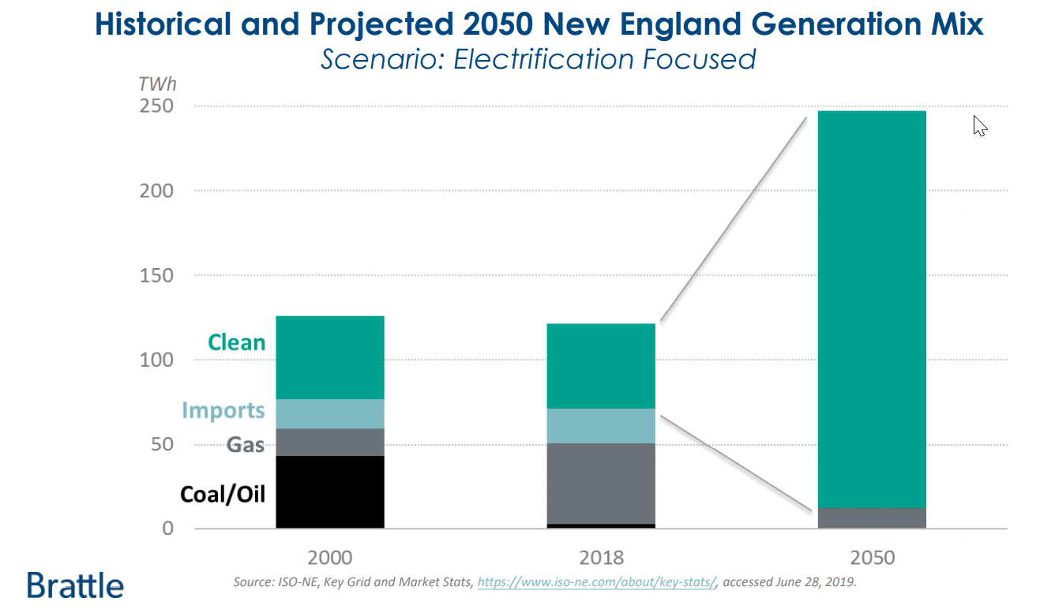
Electrification Could Double Regional Electricity Demand by 2050: Brattle Group
This will need to be supplied by clean energy resources to meet state objectives
Source: Achieving 80% GHG Reduction in New England by 2050, September 2019, The Brattle Group

Slide 13
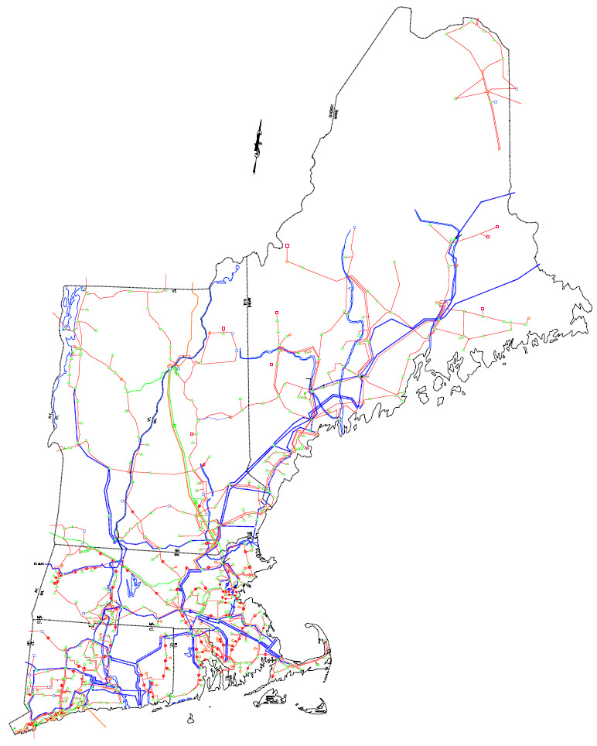
New England’s Transmission Grid Is the Interstate Highway System for Electricity
9,000 miles of high-voltage transmission lines (primarily 115 kV and 345 kV)
13 transmission interconnections to power systems in New York and Eastern Canada
21% of region’s energy needs met by imports in 2020
$11.7 billion invested to strengthen transmission system reliability since 2002; $1.1 billion planned
Developers have proposed multiple transmission projects to access non-carbon-emitting resources inside and outside the region
New Brunswick
Hydro Québec
New
York

Slide 14
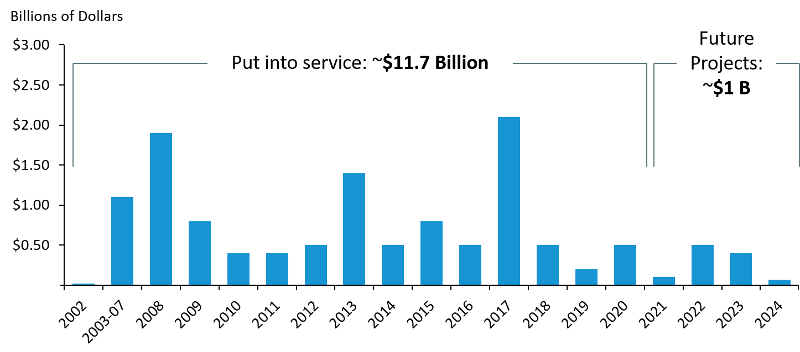
New England Has Made Major Investments in Transmission to Ensure a Reliable Electric Grid
Transmission investment by year that projects are put into service (capital costs)
Source: ISO New England RSP Transmission Project Listing, June 2021
Estimated future investment includes projects under construction, planned and proposed.

Slide 15
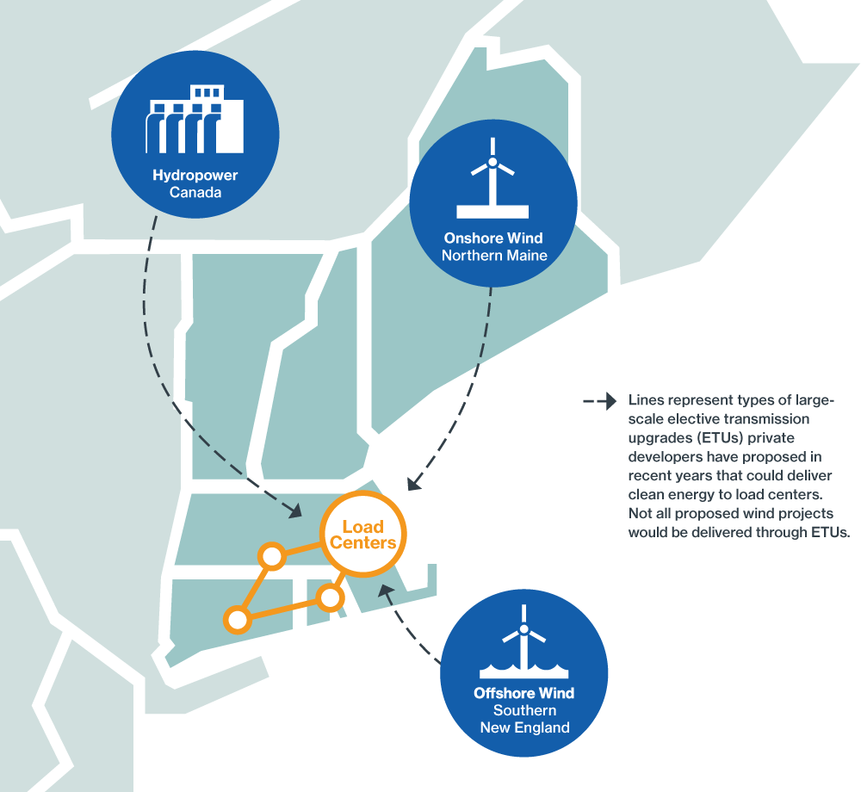
Major Transmission Investment Will Be Required to Support the Region’s Clean Energy Transition
Developers are proposing 13 elective transmission upgrades (ETUs) to help deliver about 3,400 MW of clean energy to New England load centers
Wind projects make up roughly 66% of new resource proposals in the ISO Queue
Most are offshore wind proposals in southern New England, but some are onshore wind proposals in northern New England and would require transmission to deliver the energy to load centers
We are working with NESCOE to study the investment/cost implications of the states’ 2050 Vision for the transmission system
In July, FERC announced it is revisiting transmission planning and cost allocation nationwide to further enable clean energy
Changes will be required to our transmission planning tariff, including a cost allocation methodology for this transmission
Lines represent types of ETUs private developers have proposed in recent years
Source: ISO Interconnection Queue (June 2021)

Slide 16
Energy Storage Is a Key Part of the New England Power Grid’s Past, Present, and Future
Two pumped-storage hydro facilities have operated in New England since the 1970s
These resources can supply up to 1,800 MW of power within 10 minutes for up to 7 hours
In 2016, together with our stakeholders, the ISO began efforts to enable other energy-storage technologies to participate in the wholesale markets
The ISO filed the Energy Storage Device Project in Oct. 2018 and FERC approved it, effective April 2019
The project largely addressed the major requirements of FERC Order 841, issued in Feb. 2018
Currently, about 20 MW of batteries are dispatchable by the ISO, with many more proposed
Notes:
FERC Order accepting tariff changes: https://www.iso-ne.com/static-assets/documents/2019/02/er19-84-000.pdf
ISO proposal for battery storage revisions:
https://www.iso-ne.com/static-assets/documents/2018/10/er19-84-000_enhanced_storage_revisions.pdf
From that filing:
In early 2016, in response to this growing interest, the ISO began working to build a platform that would enable batteries and other similar technologies to participate more fully in the wholesale markets. When the Commission issued Order No. 841 in early 2018,14 the ISO had already completed the internal design work for the Storage Revisions being filed here, and the process of vetting those revisions with NEPOOL was already scheduled. On reviewing Order No. 841, the ISO determined that the changes already being developed and vetted would bring the region a long way toward compliance with Order No. 841, but that some work would remain. This presented the region with a choice: either delay the instant changes until a fully compliant set of changes could be developed, or proceed with the instant filing as planned and file the remaining elements required for full compliance separately by the compliance deadline.

Slide 17
What Does the Future Grid Look Like? There are two dimensions to the transition, happening simultaneously…
1
A shift from conventional generation to renewable energy
2
A shift from centrally dispatched generation to distributed energy resources
Coal
Oil
Nuclear
Gas
WIND
Solar
Storage & other technologies
Maintaining reliable power system operations becomes more complex with the shift to greater resources that face constraints on energy production

Slide 18
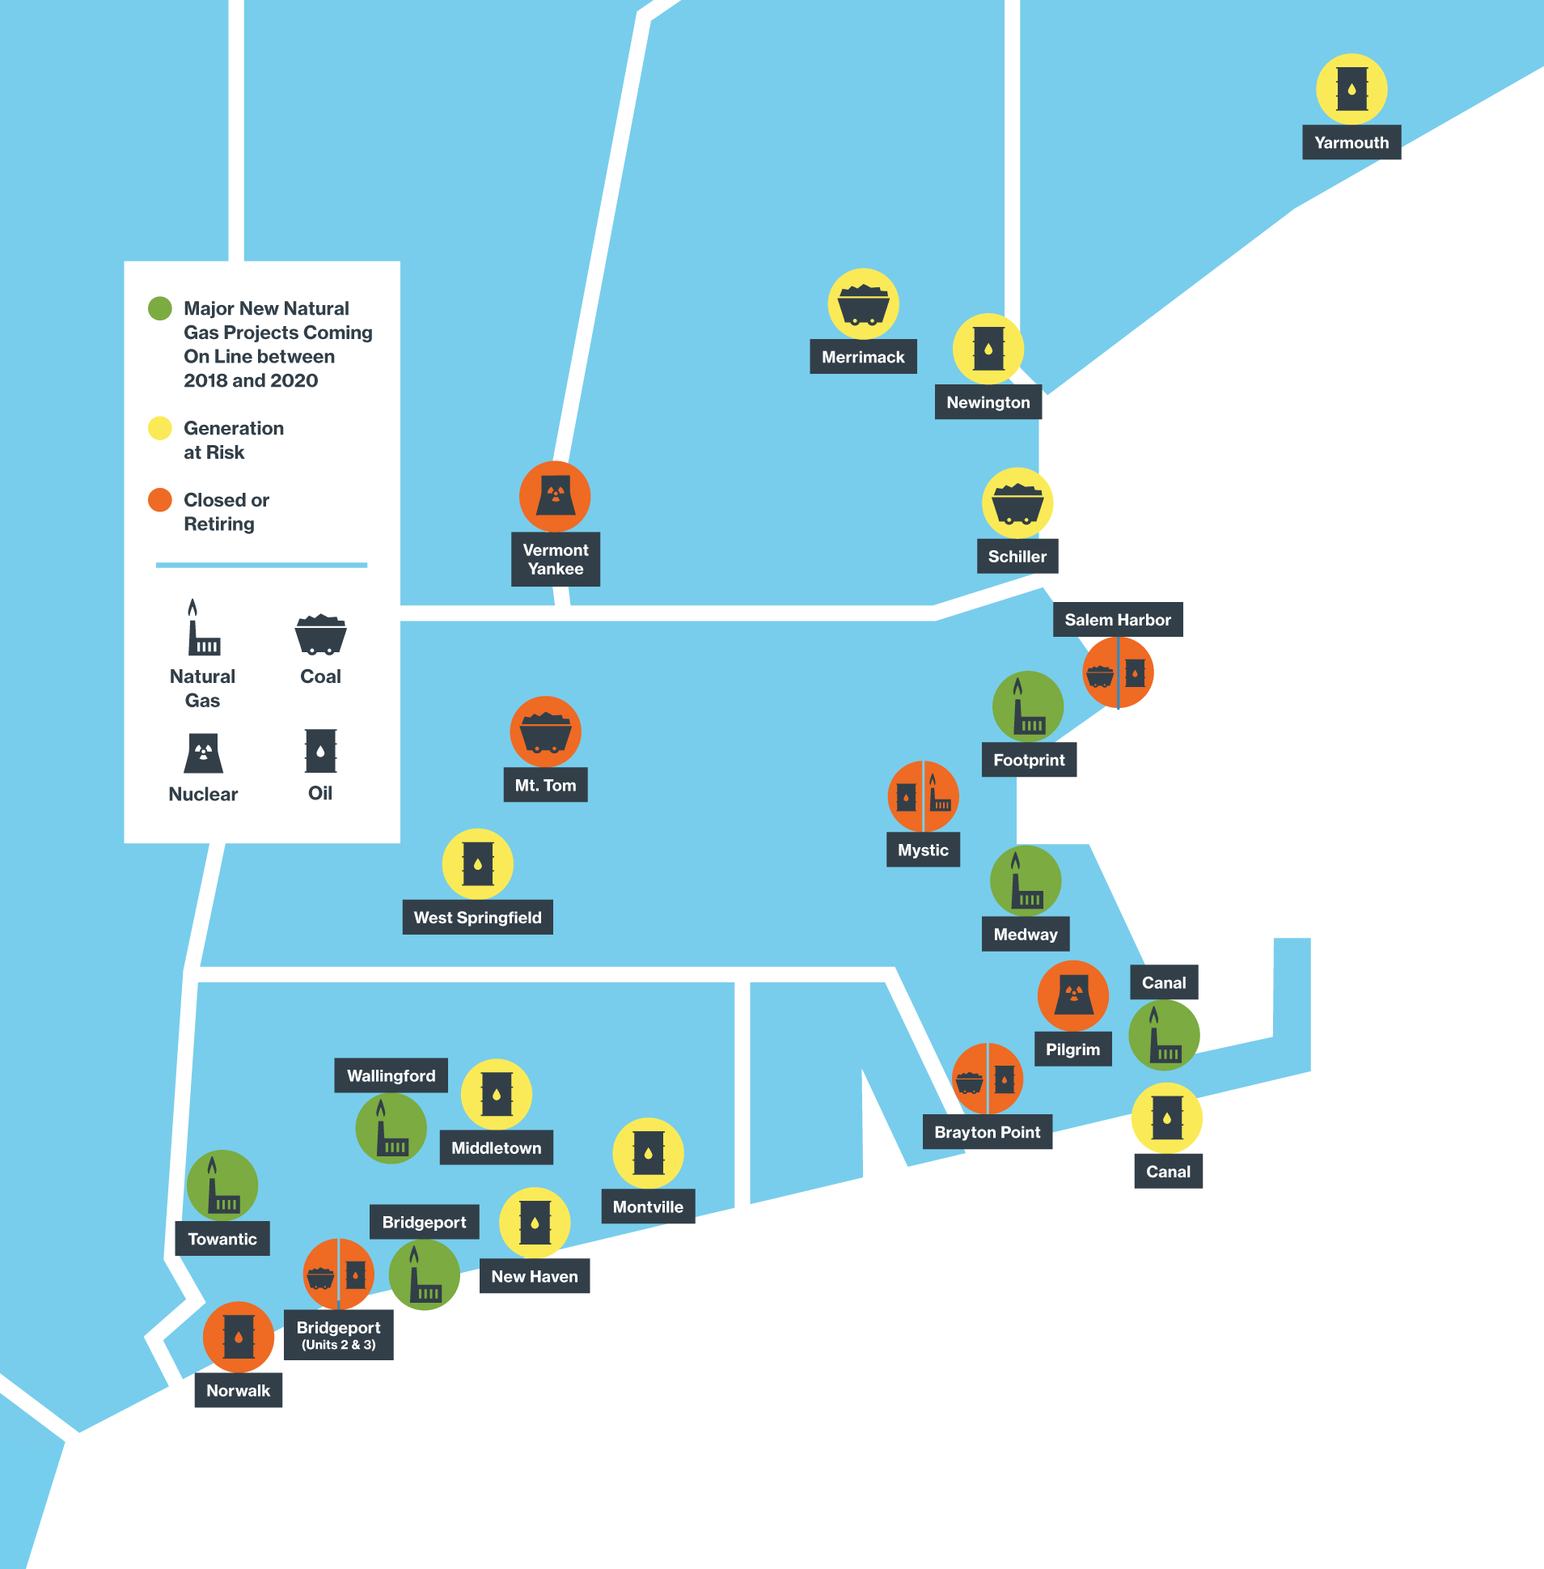
Since 2013, Roughly 7,000 MW of Generation Have Retired or Announced Plans for Retirement in the Coming Years
Include predominantly coal, oil, and nuclear resources
Another 5,000 MW of remaining coal and oil are at risk of retirement
These resources have played an important role in recent winters when natural gas supplies are constrained in New England
Source: ISO New England Status of Non-Price Retirement Requests and Retirement De-list Bids (January 2021)

Slide 19
New England’s Generation Fleet Relies Increasingly on “Just-in-Time” Energy Sources: Gas, Renewables Historically, most resources had large, ready stockpiles of fuel
Retirements of legacy resources, growth of renewable resources, and continued gas pipeline constraints could leave the region untenably reliant on “just-in-time” resources
The ISO plans further discussions with the states and stakeholders for addressing market-based reliability solutions after FERC’s rejection of the ISO’s Energy Security Improvements (ESI) proposal
The ISO is looking to develop a design to help ensure that enough flexible supply is available each day to manage uncertainties in an increasingly energy-limited power system
Energy Adequacy is critical now and in the future

Slide 20
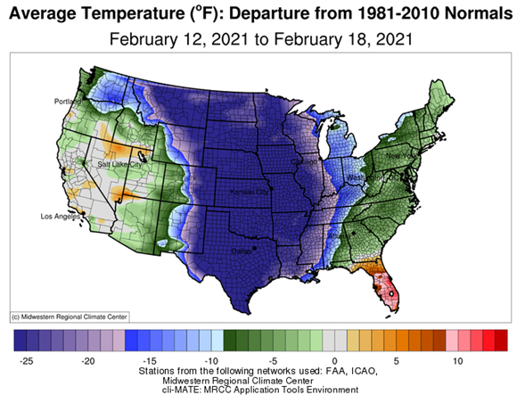
Extreme Cold Was Widespread During Crisis in Texas
Source: Midwest Regional Climate Center

Slide 21
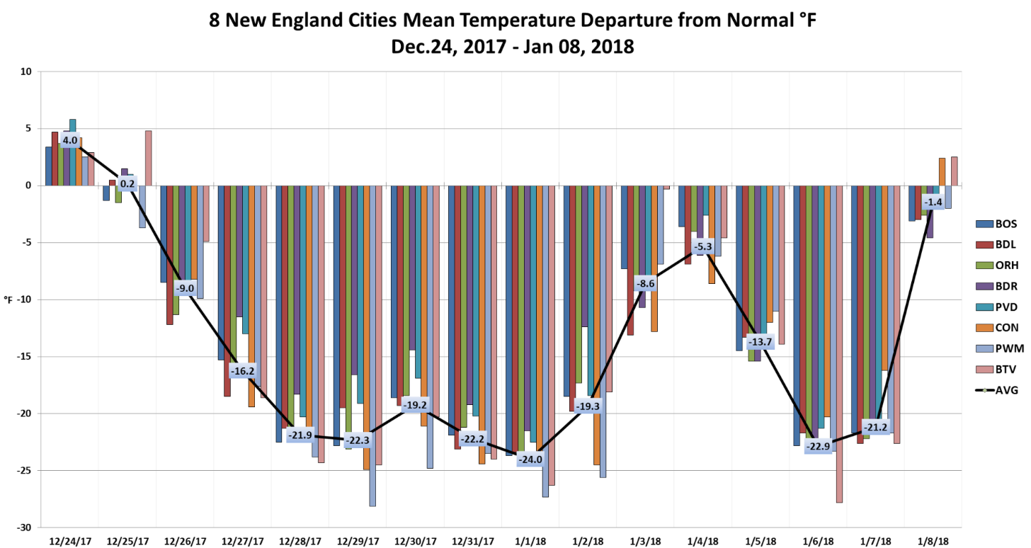
New England Temperatures Fell Well Below the Winter Average in Late Dec., and Early Jan. 2018 And temperatures stayed well below average for a two-week period
Source: ISO New England, Post Winter 2017/2018 Review, Electric/Gas Operations Committee

Slide 22
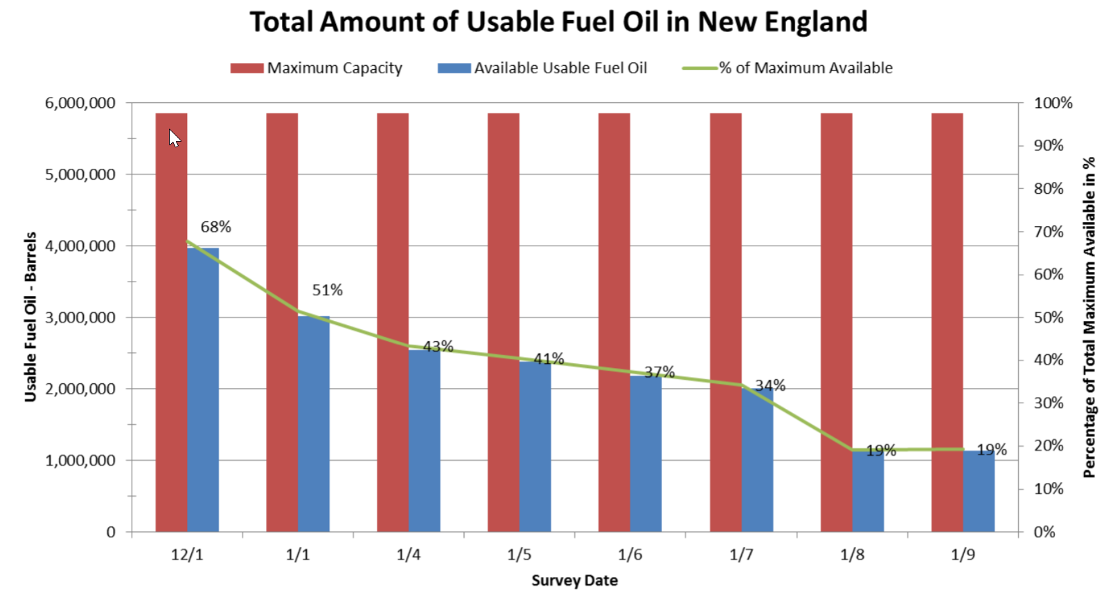
Cold Weather Exposes Reliability Risks in New England In-region oil supplies dwindled during early January 2018 cold-weather event
This chart is the ISO’s best approximation of usable oil discounted for unit outages, reductions, or emissions
Source: ISO New England, Post Winter 2017/2018 Review, Electric/Gas Operations Committee

Slide 23
Texas Events Hold “Lessons Learned” for New England
Truly extreme weather may be beyond current ISO planning for winter conditions
Should we plan for colder extremes?
How should we account for low-probability events (a.k.a. “tail risks”)?
Lack of winterization in Texas is not comparable to New England
However, regional infrastructure may not be prepared for more regular instances beyond current (“90/10”) planning assumptions
In the future, New England could face increased energy adequacy risks from the simultaneous loss of energy inputs to both gas-fired and renewable generation
New England has long had some form of an energy adequacy problem

Slide 24
Texas Events Hold “Lessons Learned,” cont.
The underestimated demand from electric heating exacerbated the imbalance between supply and demand
New England is planning to electrify much of its heating and transportation, which will increase demand, particularly in the winter
What is the appropriate reliability standard for a grid that is supplying energy to all sectors of the economy? Is it 1 day in 10 years, 1 day in 40 years, or something else?
FERC/NERC will likely create new reliability standards to address winterization, as well as an assessment of energy adequacy
Regions will all need to assess how much risk they want to mitigate versus accepting the risk of controlled outages
If controlled outages are needed, can the electric distribution companies rotate outages when required?
ISO-NE, the distribution companies, and state regulators need to work together to ensure the ability of distribution companies to implement controlled outages
The ISO has well-developed cold weather protocols, but we continue to assess the unique risks for New England

Slide 25
Regional Discussion to Begin Regarding Extreme Weather and Contingency Events New initiative will consider New England’s reliability risks from severe weather events
The events in Texas have caused the ISO to further evaluate whether the region is adequately assessing and preparing for low-probability, high-impact reliability risks
The ISO plans to initiate a process later this year to discuss approaches to modeling tail risks related to extreme weather events and contingencies
This process will:
Initially focus on understanding the modeling approaches to quantify such risks, and
Subsequently focus on understanding if and how the region should protect against the risks

Slide 26
Studying the Evolution of New England’s Future Grid ISO is engaged in a myriad of market, planning studies and discussions
Future Grid Reliability Study: Stakeholder-led assessment of the future state (2040) of New England’s power system under current energy and environmental policies
Pathways to the Future Grid: Regional identification, exploration, and evaluation of potential wholesale market frameworks that reflect states’ policies
The ISO is studying the efficacy of a regional net carbon price, a Forward Clean Energy Market, and a hybrid of the two concepts
The ISO continues to support net carbon pricing as a solution that integrates seamlessly with the wholesale markets
This would allow the New England states to achieve their environmental policy goals while allowing the most efficient fossil-fired resources to remain economically viable and gradually transition to clean fuels (e.g., clean hydrogen)
The FCEM concept would allow states to determine the level of demand for clean energy in a separate market framework to pay for these attributes
We expect study results in Q2 2022

Slide 27
Studying the Evolution of the Future Grid, cont. ISO is engaged in a myriad of market, planning studies and discussions
2050 Transmission Study to help states determine how to expand the system to incorporate wind, hydro, and distributed energy resources, in support of their Vision
In addition, the ISO is evaluating FERC’s Advanced Notice of Proposed Rulemaking (ANOPR) focused on transmission planning and cost allocation for future investments in the electric grid
Other key studies/initiatives:
Eliminate the Minimum Offer Price Rule (MOPR)
ISO filing to FERC expected in Q1 2022
Improve Resource Capacity Accreditation for resource adequacy (e.g., ELCC)
Reassess day-ahead ancillary service improvements
Evaluate operational impacts of extreme weather and contingency events
Develop approach for Distributed Energy Resource Aggregations (Order 2222)
ISO filing to FERC due in Feb. 2022

Slide 28
Key Takeaways
New England is transitioning to a power system with heavy penetration of renewable energy resources in order to meet state environmental objectives
Transitioning away from generating resources with on-site fuel storage
Flexible resources will be needed to balance the variability of renewable energy
The market design needs to ensure we can attract and retain the resources needed throughout the clean energy transition
New England, as a region, needs to evaluate the amount of risk we can live with for extreme weather events, whether to mitigate those risks, by how much, and by whom

Slide 29
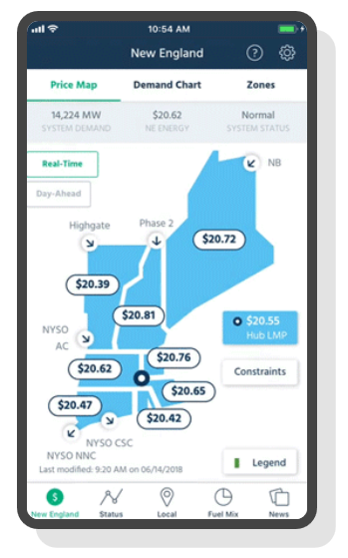
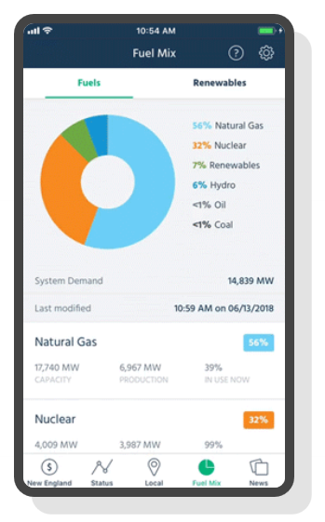
FOR MORE INFORMATION…
Download the ISO to Go App
ISO to Go is a free mobile application that puts real-time wholesale electricity pricing and power grid information in the palm of your hand
Subscribe to the ISO Newswire
ISO Newswire is your source for regular news about ISO New England and the wholesale electricity industry within the six-state region
Log on to ISO Express
ISO Express provides real-time data on New England’s wholesale electricity markets and power system operations
Follow the ISO on Twitter
@isonewengland
Follow the ISO on LinkedIn
@iso-new-england

Slide 30
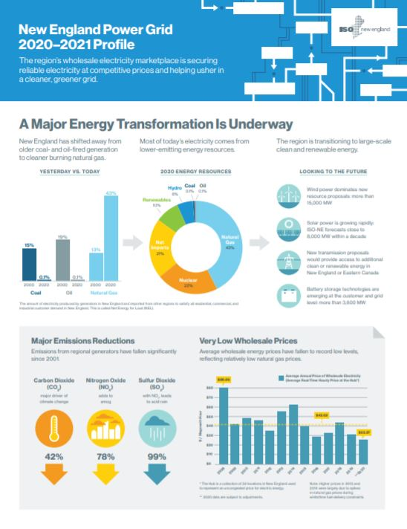
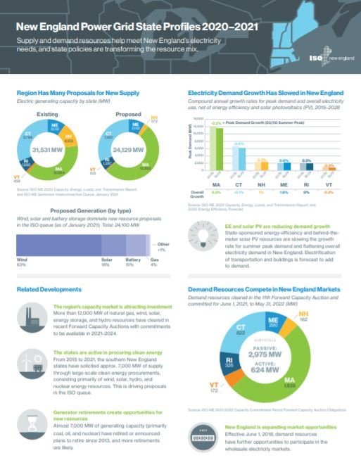
ISO Releases Regional Electricity Outlook and Profiles
2021 Regional Electricity Outlook
Provides an in-depth look at New England’s biggest challenges to power system reliability, the solutions the region is pursuing, and other ISO New England efforts to improve services and performance
New England Power Grid Profile
Provides key grid and market stats on how New England’s wholesale electricity markets are securing reliable electricity at competitive prices and helping usher in a cleaner, greener grid
New England State Profiles
Provides state-specific facts and figures relating to supply and demand resources tied into the New England electric grid and state policies transforming the resource mix in the region

