Slide 1



Washington Update
NEPPA Annual Conference | August 18, 2026

Slide 2
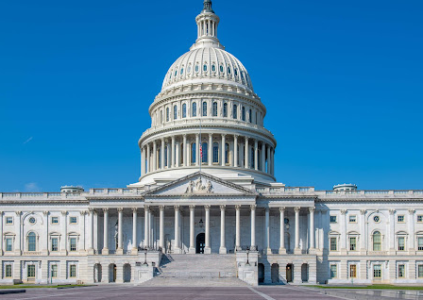
Overview
Trump Administration: Term 2, Year 2
Permitting reform
Energy and AI
FEMA reform
Pole attachments
A Look Ahead…

Slide 3
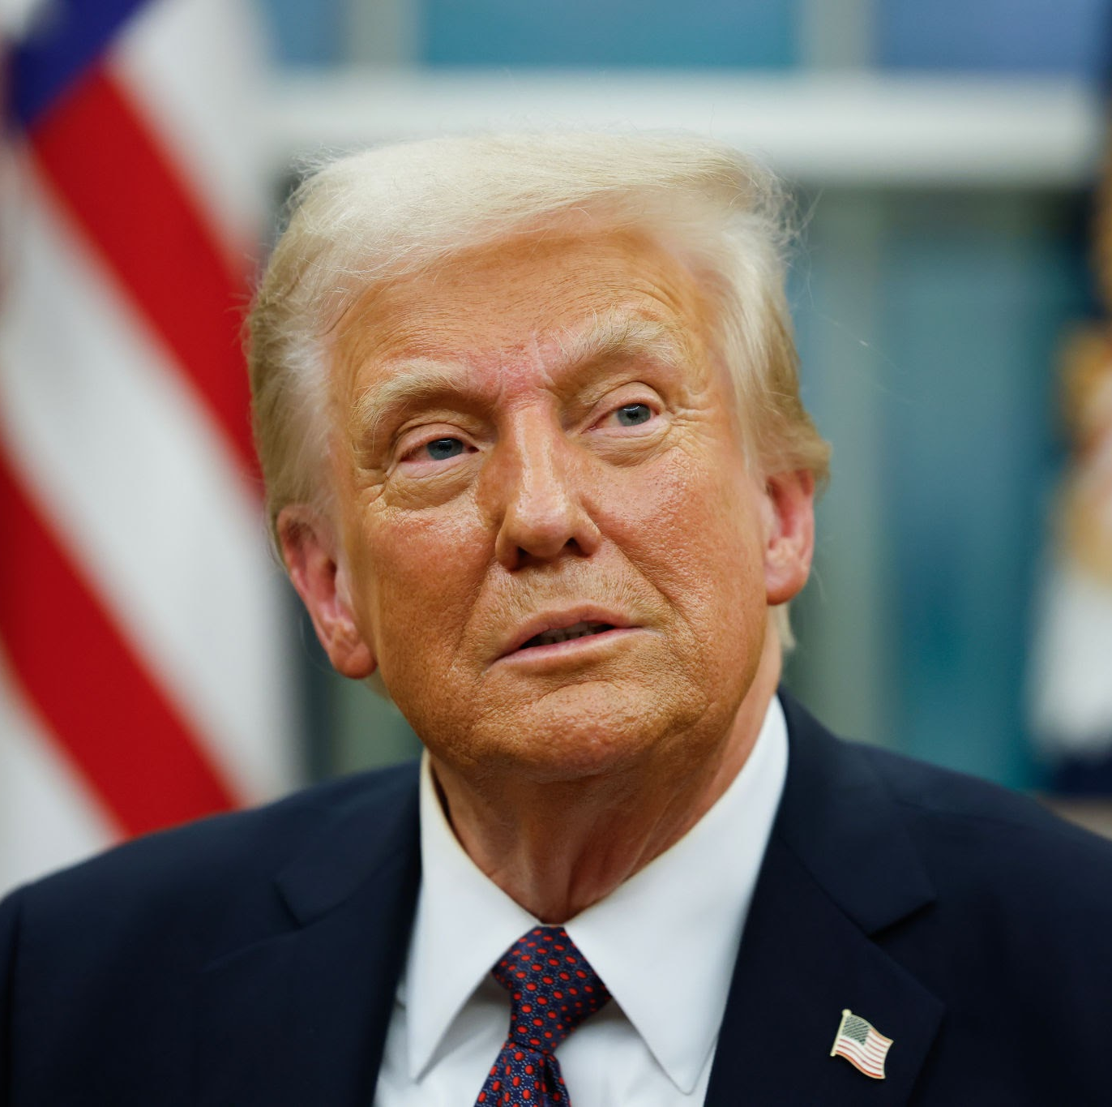
Trump Administration: Term 2, Year 2
Testing the limits of Executive authority
The return of federal funding
Regulatory rollbacks continue
Reconciliation or bust
Energy affordability challenges

Slide 4


Energy and AI
Speed to Power → Affordability
Ratepayer Protection Pledge
FERC Large Load Rulemaking
PJM pandemonium

Slide 5
Energy & Technology Policy Converge
White House
Agencies
FERC & RTOs
Congress
AI Action Plan and Energy Dominance Council
Executive orders on energy emergency
Ratepayer Protection Pledge
DOE 202(c) reliability orders
Permitting discretion at Interior and EPA
LPO and grant dollars redirected
Co-location cases, driven by PJM
Interconnection queue reform grinds on
June 18 show-cause orders
Reliability → data centers
Permitting reform → FERC oversight
Still searching for its role
Will continue:
Watch for:
Federal hostility to intermittent resources · deregulation and faster permitting · dispatchable power prioritized · bold, fast policymaking in Exec branch vs. legislative gridlock
Wholesale market reform · a federal energy “Blueprint” · direct intervention in markets · Congress finding its footing
The direction is clear — but how far can Washington intervene?

Slide 6
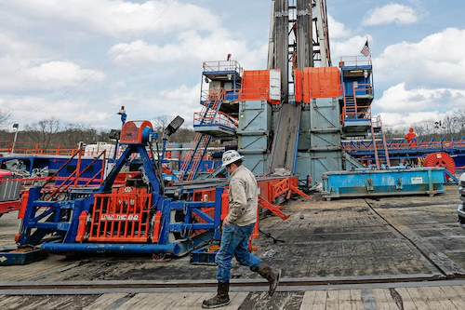
Permitting Reform
SPEED Act etc.
Permit certainty
Transmission?

Slide 7
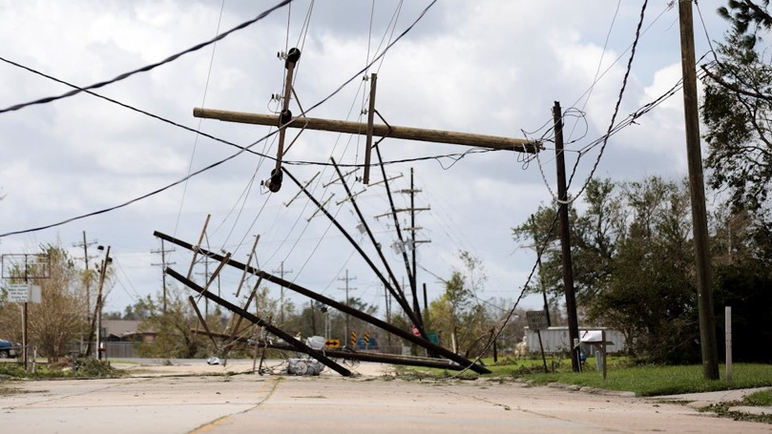
Federal Emergency Management for
Americans (FEMA) Act
Re-establishes independent, cabinet-level agency status
  Removes bureaucratic burdens found within DHS and empowers FEMA Administrator to improve coordinated disaster response
Public Assistance Reforms
  Time deadlines to expedite delivery of federal recovery funds; streamlines environmental and historic preservation reviews
Individual Assistance Reforms
  Universal disaster application to be used across multiple federal agencies; requires clear notices from FEMA to disaster survivors to reduce confusion
Hazard Mitigation Reforms
  Encourages proactive hazard mitigation planning and infrastructure hardening prior to disasters; focuses on high-risk areas
Transparency and Accountability
  Public dashboards and tracking tools; GAO review of policies and fraud risks

Slide 8
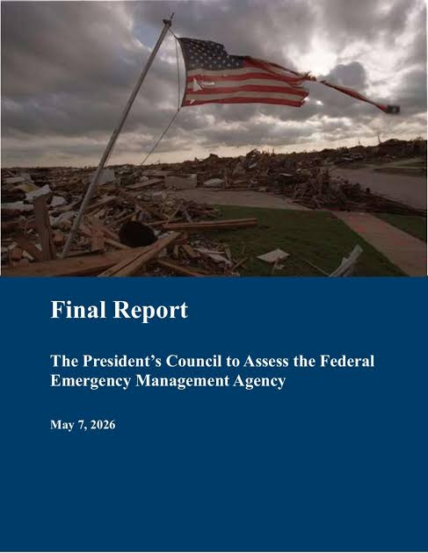
FEMA Review Council Report
Key items in Final Report
(released in March 2026)
Federal cost-share shift: From 75% to 50%
Higher Aid Thresholds: Restricting disaster declarations strictly to "catastrophic events exceeding state capacity.“
HMGP Restructuring: Replace with immediate rapid-repair funds paired with secondary long-term risk reduction funds.

Slide 9
Pole Attachments
H.R. 2289
American Broadband Deployment Act of 2026
FCC NPRM
Wireline Deployment, WC Docket No. 25-253
Rolls ~20 permitting bills into one package; Sec. 102 sets federal “shot clocks” for local review
“Deemed granted” remedy if deadlines are missed
Amended after public power advocacy: Sec. 224-exempt utilities carved out of Sec. 102
Reported to the House April 2026
Status: amended to protect public power, floor vote pulled
Adopted June 2026; seeks comment on broadening Sec. 253 over wireline permitting
Could subject public power to oversight Congress declined to impose under Sec. 224
Latest in a line of dockets since 2016 narrowing the municipal exemption
APPA: public power acts as a market participant, not a regulator
Status: open threat — active concern
The ask: preserve local control of community-owned poles — local review is not delaying buildout

Slide 10
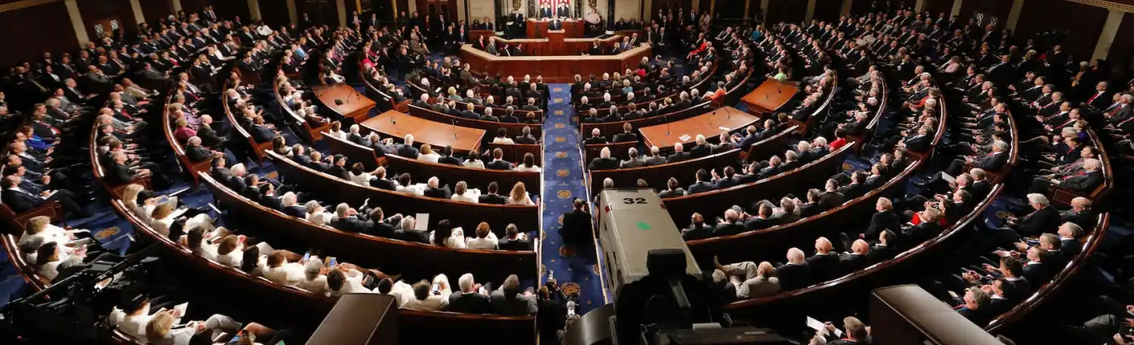
Midterm Elections Preview
The map — seats in play, New England races
Fundamentals — historical trends vs. new trends
Committees — party rules and politics determine gavels

Slide 11
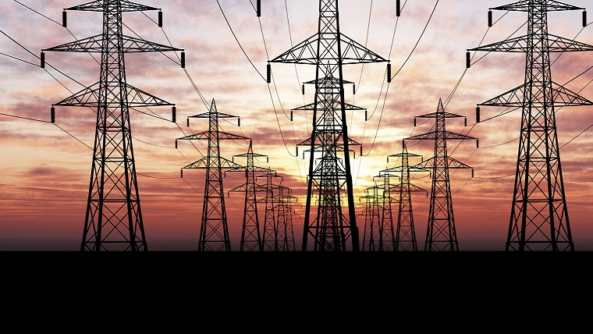

Questions
Elizabeth K. Whitney
Managing Principal | Elizabeth@meguirewhitney.com

