Slide 1
Affordability, Infrastructure, Climate, and Demand Growth
Practical pathways to reconcile emerging challenges
Paul J. Hibbard
Principal, Analysis Group
August 2026

Slide 2
Agenda
  The electricity “ven diagram,” and emerging fractures
  Understanding the forces at work
  What solutions are available?

Slide 3
Equilibrium: Reliability, Affordability, and Sustainability
  Traditional goal of electric, gas regulation and operations
  Reliability first among equals
  Always a balance, yet rarely perfectly in balance
  Balance is affected by generation choices, cost escalation, market forces, policy choices
RELIABILITY
AFFORDABILITY
IMPACT; SUSTAINABILITY

Slide 4
Fractures in the Equilibrium
Cost escalation, supply chain impacts on infrastructure
Natural gas market dynamics and constraints
Large load Gen, T&D needs
Large load operational impacts
Transmission, storage to operationalize carbon free resources
RELIABILITY
Demand growth
Infrastructure needs
Winter peak fuel use (gas infrastructure constraints)
Large load Generation
Variability of some carbon-free generation, limits to storage
  Reliability remains first among equals
  Balance has recently shifted by cost escalation, natural gas market forces and constraints
  Large loads, electrification threaten to further destabilize the balance over the next decade
AFFORDABILITY
Market cost of constrained natural gas infrastructure
Large load Gen, T&D
Carbon abatement cost curve impact on deeper reductions
T&D needs to manage electrification, distributed resources
IMPACT; SUSTAINABILITY

Slide 5
Drivers of “energy affordability”* now
  What it is:
    Weather
    International and national natural gas market dynamics (e.g., war, international supply/demand, LNG exports)
    Lack of natural gas infrastructure to move gas through New York
    Constraints on peak gas delivery infrastructure in New England
    Everett Marine Terminal contracts (for MA gas customers)
    T&D cost escalation
    Lack of adequate demand response on both natural gas and power systems
  What it is not (yet):
    Large load/data centers
    Electrification/climate policy
    MassSave, energy efficiency, demand response (on average, and for participants)
    Ratemaking policy
    Existing low/zero-carbon resources (grid connected or distributed)
  What may contribute over the next decade:
    Large load/data centers, absent appropriate interconnection and regulatory treatment
    Electrification/climate policy, depending on technological change, market changes, and policy administration
*”Energy affordability” accounts for total household energy use (electricity, heating, transportation). Affordability metrics must recognize reductions in fuel and gasoline costs alongside cost increases due to electrification.

Slide 6




Four Forces at Work: Current and Potential
Natural Gas Access & Pricing
Supply Chain Constraints & Cost Escalation
Large Load Growth (Potential)
Electrification (Potential)
Wars, international LNG demand, and winter peak supply constraints leave the region exposed to natural gas price spikes that set the marginal cost of electricity, and need for liquid fuels at higher CO₂ emission rates.
Availability and cost of EVERYTHING – generation, transmission, and distribution infrastructure – qualitatively changed from just several years ago. This increases the cost of needed system infrastructure and generation to meet load growth and ensure reliability.
It may also elevate the cost of meeting future load growth from large loads, electrification
Data centers and other large load – current and planned – are minimal today, but are a potential threat to reliability, affordability, and carbon emissions.
Building and vehicle electrification has not taken hold in a meaningful way, yet. But under current cost/availability conditions, development of generation, transmission and distribution infrastructure to meet growth in vehicle and heating load will exacerbate affordability challenges over time.

Slide 7
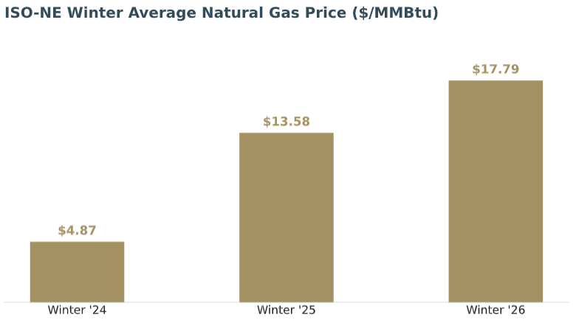
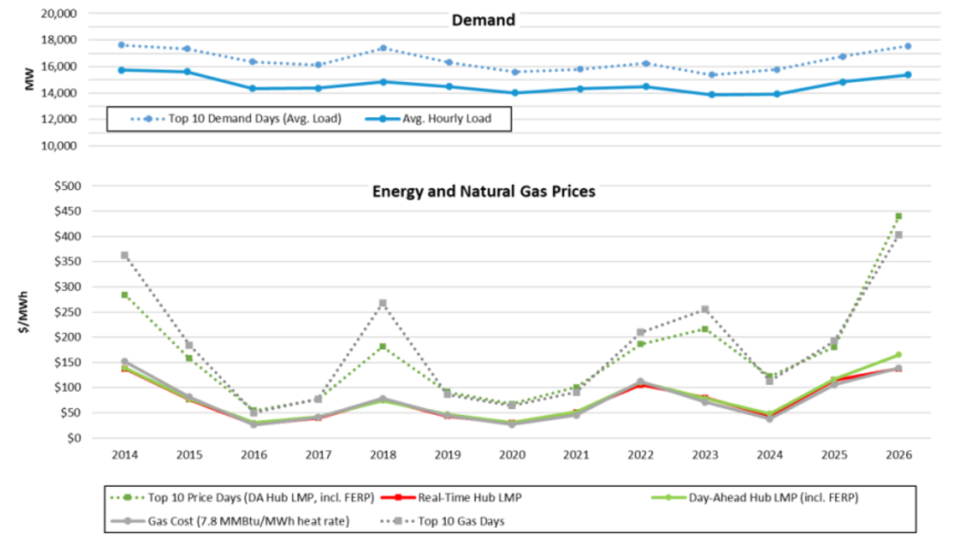
Affordability = Natural Gas Prices
Metric | Winter '24 | Winter '25 | Winter '26
Average temperature | 34°F | 28°F | ~26–27°F (coldest in 20 yrs)
Days under 20°F (avg. daily temp) | 3 | 13 | 19 consecutive days ≤32°F
Longest cold stretch | 2 days | 6 days | 19 days
Coldest stretch avg. temp | — | ~13°F (peak day) | ~15°F over 19 days; 6.3°F on single coldest day
Winter gas price ($/MMBtu) | $4.87 | $13.58 | $17.79
1
Weather
$38/Mwh
$106/Mwh
$139/Mwh
Cold winter conditions strain New England’s gas supply infrastructure and lead to sustained high prices. Increasing winter peak demand (for electricity, net of gas demand declines) due to electrification and/or large loads will make things worse.
2
Delays/Cancellations of Non-Gas Infrastructure
Offshore wind and transmission project delays and interruptions leave the region temporarily more dependent on existing gas-fired (and oil-fired) generation than expected.
3
Everett Marine Terminal
The EMT helps meet winter peak gas supply, but at an extremely high cost to natural gas customers in MA. Its contribution to moderating electricity prices is marginal.
4
Infrastructure Constraints
Limited infrastructure capacity moving gas through New York and into New England results in constrained supplies in New England and price scarcity conditions in New England. Increasing throughput capacity through NY and in NE would help moderate peak winter pricing.
ISO-NE, Winter 2026 Quarterly Markets Report

Slide 8
Supply Chain Constraints and Cost Escalation
Building new capacity and building/upgrading T&D infrastructure is taking longer and costing more
Offshore Wind (OSW) Pricing
Cost Pressure | Trend
OSW contract bids | Higher strike prices, longer tenures, cost escalation indices
Other power plants - turbine/equipment lead times | Tight supply/demand conditions; increased cost, multi-year delays
T&D build and upgrade costs | Constrained supply; escalating cost for all components
1
OSW contracts have been offered at higher prices than the original 2010s-era procurements, raising the cost of the region’s key zero-carbon generation source.
Other Generating Capacity: Pricing & Availability
2
Turbine and major equipment lead times of several years are delaying new gas, solar, and storage projects alike, tightening the supply and increasing the cost of new capacity across the board, increasing procurement and capacity market costs.
Escalation of T&D Costs
3
Transmission and distribution new build and upgrades needed to interconnect new generation and serve growing loads have seen material cost increases, a situation that will become even more difficult as systems are built out to accommodate electrification and the interconnection of distributed energy resources.

Slide 9
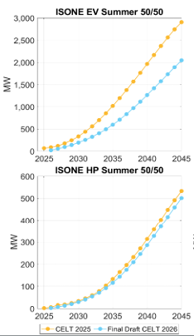
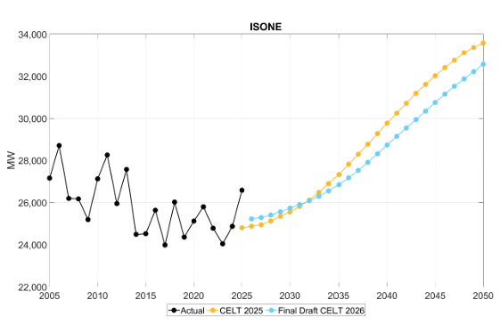
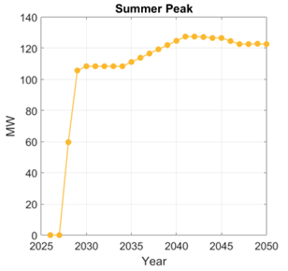
Large Load and Electrification – in the Future … Maybe
Large Loads
ISO-NE Presentation, April 2026, Final Draft Load Forecast

Slide 10
Potential Future Strains on Affordability
Emerging Challenges
Impact on the Electric Grid
Resulting Types of Power System Requirements
Greater generating capacity need; increased annual energy
Greater demand for power during cold winter peaks
Tech requirements and adaptation of system operating procedures to manage sudden loss of large loads
Absorption of available T capacity
Need for new T infrastructure
Absorption of available D system capacity
Buildout of local distribution network to support interconnection
Advanced Metering Infrastructure
Integration of DERs, with controls to give grid operators visibility into demand fluctuation
Buildout of public EV charging infrastructure
Large Loads: Rapid development of new large loads exceeding ISO-NE current forecast
New supply needs; increase in capacity market prices
Greater reserve and ancillary service needs?
Interconnection impacts on T&D
Increased load and peak demands
Shifting load shapes/patterns, including increased demand response
Transportation: Electrification of vehicle fleet
Buildings: Electrification of heating systems and other fossil end-use technologies
Increased load and peak demands
Shifting load shapes/patterns, including increased demand response
Distributed Energy Resources: Increased adoption of residential and commercial DERs, predominantly BTM solar and storage systems
Bi-directional flow capability in the distribution system
Interconnection of DERs
Increased potential for demand response and flexible loads

Slide 11
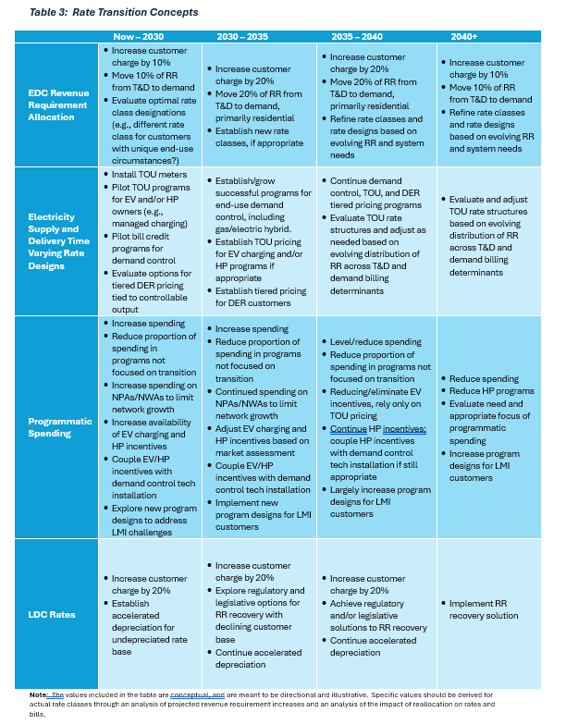
What Solutions Are Available: Supply and Demand
  Create the financial conditions for price-responsive demand
    Evolve rate designs over time, but starting now
      Increasing customer charges
      Increased demand-based charges
      Declining energy charges
      Aggressive and dynamic TOU pricing structures
    Actively engage customers and third-party suppliers
      Focus programmatic investments away from energy conservation, and towards demand reduction (bidirectional EV capability, peak load response, circuit-specific measures)
      Engage technology and software in customer demand management
  Cross our Fingers
      Hope that generation and infrastructure supply catches up with demand, moderating prices, increasing availability, and decreasing wait times

Slide 12
What Solutions Are Available: Infrastructure Planning, Development, and Cost Allocation
Structural fixes to planning, gas delivery and policy design may help close the gap
  Incremental in-region peak gas delivery capability
      Consider incremental gas delivery capacity in New England to the extent there is additional throughput available through New York
  Address Everett Marine Terminal Situation
      Ensure that LDCs pursue infrastructure and demand management to eliminate any actual reliability needs related to EMT (greater Boston LDC system pressure), to avoid costly non-market contracts going forward
      Develop mechanisms that encourage all LNG sources to provide more peaking gas supplies on a competitive market basis
  Better T&D Planning, Demand Response Integration & Cost Allocation
      Integrate T&D planning with demand reduction opportunities and forecasts of data center, distributed resource, and/or electrification load growth/change
      Evaluate opportunities for targeted demand response to address current/future local delivery system constraints
      Be prepared to address issues around interconnection and fair allocation of costs associated with large loads and distributed resources
  Evaluate allocation of costs related to infrastructure policy mechanisms
      Are the social benefits of policy mechanisms – solar net metering, distributed resource interconnection rate treatment, OSW long term contracts – equal to their costs? If not, adjust the balance
      Are the costs of such mechanisms fairly allocated to beneficiaries (e.g., avoid “overcompensation” of solar net metering customers)

Slide 13
Wrap Up
  Cost escalation, ongoing gas system constraints, and a couple cold winters, have put a bullseye on the affordability of electricity service
      Large loads and electrification/climate policy are not yet meaningful contributors, but…
  Large load growth and electrification of the vehicle and building sectors have the potential to create further strains on electricity affordability
      If demand growth from these sources materializes, it will increase the strain on the region’s grid and gas infrastructure, and the frequency and magnitude of elevated natural gas and electricity prices
  The practical solutions that exist focus on managing peak electricity and gas usage, regionally and locally
      Engage the demand side through forward-looking rate design, programmatic spending on demand management technologies and systems, and enabling a market for demand management services
      Focus on increasing market-based pipeline and LNG delivery under cold winter conditions
      Continue to proactively engage in distribution system planning to optimize available delivery capacity and minimize incremental infrastructure needs
      Continuously evaluate policy mechanisms to balance costs and benefits, and ensure fair allocation of associated costs

Slide 14
Contact Information
Paul Hibbard, Principal
(617) 425-8171
phibbard@analysisgroup.com

