Slide 1

Alternatives to New England’s Energy Affordability Crisis
Northeast Public Power Association Annual Conference
August 18, 2026
Sarah Montalbano, Energy Policy Analyst
Always On Energy Research

Slide 2


About Me
I am an energy policy analyst at Always On Energy Research, where I research and write about energy and natural resources issues.
My writings have appeared in The Wall Street Journal, The Washington Post, National Review, the New York Post, and more.
I graduated with a B.S. in computer science from Montana State University.
I grew up in Wasilla, Alaska, and my first summer job out of high school was doing PR for one of the electric cooperatives up there!

Slide 3
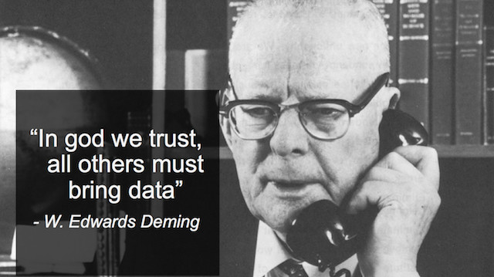
About Always On Energy Research
A 501c(3) founded in May of 2024.
Always On Energy Research believes all Americans deserve access to reliable, affordable energy.
Our modeling brings quality data to policy debates that are sorely lacking it.
We assess the reliability and financial implications of federal and state policies and work with decision-makers to enact common-sense energy reforms.
Our clients include state agencies, industry stakeholders, hedge funds, and public policy organizations throughout the United States.

Slide 4
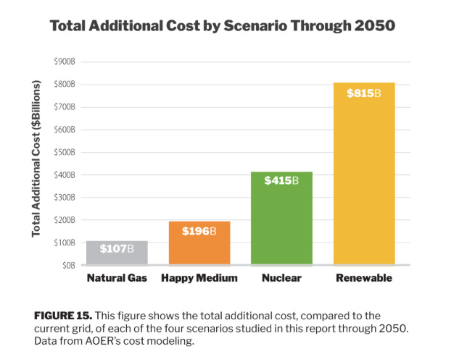
Key Takeaway: Natural Gas and Nuclear are Much More Affordable than Wind, Solar, and Storage
Our report calculated the cost and reliability implications of decarbonizing the electricity sector and “electrifying everything” in New England under four scenarios.
Relying on nuclear and natural gas will save the region hundreds of billions of dollars through 2050 compared to the renewable scenario and prevent rolling blackouts.

Slide 5
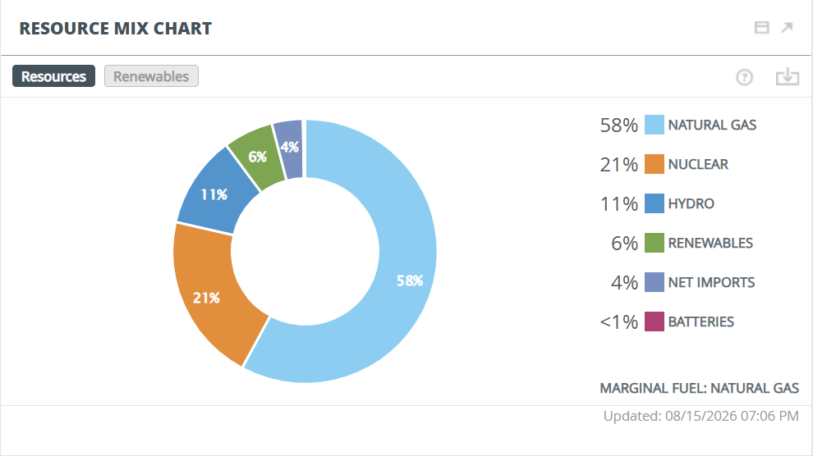
New England’s Current Energy Mix
August 15, 2026, 7 p.m.
ISO-NE was dependent upon natural gas (58%) and nuclear (21%).
Hydro (11%) and smaller shares of renewables (6%) and imports

Slide 6
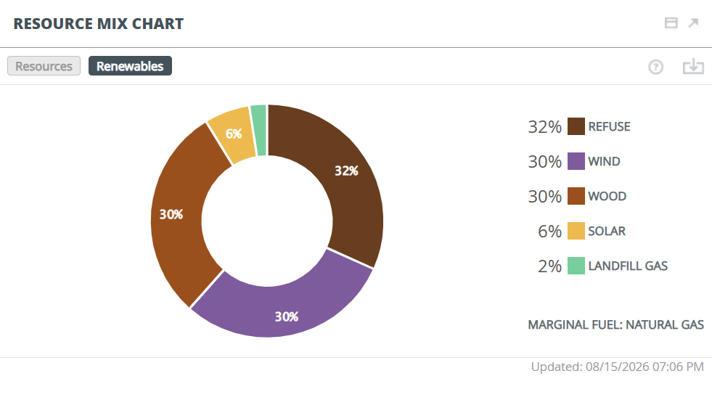
New England’s Current Energy Mix
August 15, 7 p.m.
30 percent was wind. The ISO does not break down onshore vs offshore.
About 62 percent was burning trash or wood.
Only 6 percent solar as sunset approached

Slide 7
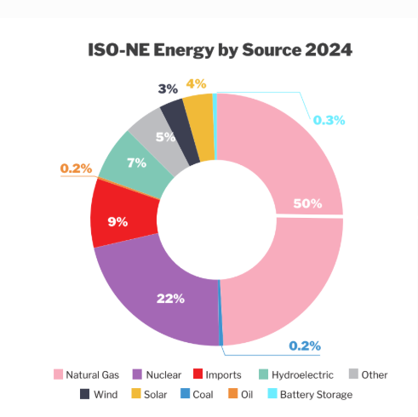
New England’s 2024 Energy Mix
In 2024, the region’s electricity came from:
  Natural gas 50%,
  Nuclear 22%,
  Imports 9%,
  Hydro 7%,
  Other 5%
  Wind 3%
  Solar 4%

Slide 8
The State Policies Challenging ISO-NE
State policy commitments put cost pressure on utilities
Connecticut: 45% reductions by 2030, 100% carbon free by 2040
Maine: 80% by 2030, 100% renewable by 2050; plus, emissions reduction standards
Massachusetts: 50% reductions by 2030, 75% by 2040, and net-zero by 2050
Rhode Island: 100% renewables by 2033, most aggressive
Vermont: 100% renewables by 2030 for GMP, 2035 for others
New Hampshire holds the most modest RPS, at 25.2% by 2025

Slide 9
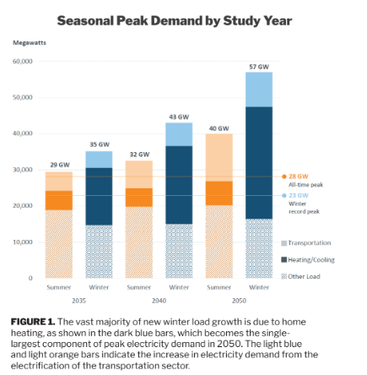
Electrifying Everything is the Main Challenge
Our research across the country has found that decarbonizing the electricity sector with wind, solar, and storage is always expensive and challenging to reliability.
But attempting to electrify everything is an even larger challenge.

Slide 10
Four Scenarios for the Energy Future
Our report calculated the cost and reliability implications of “electrifying everything” in New England under four scenarios.
The Renewable scenario: This scenario attempts to meet rising demand using onshore wind, offshore wind, solar, battery storage, and existing nuclear and natural gas facilities.
Nuclear scenario: This scenario uses existing gas and builds new natural gas and nuclear plants to meet demand, with nuclear accounting for 90 percent of the electricity mix by 2050.
Natural Gas scenario: This scenario adds new natural gas plants and pipelines to meet rising demand, with gas accounting for 83 percent of generation in 2050 and existing nuclear accounting for 12 percent.
Happy Medium: This scenario adds nuclear and natural gas capacity, resulting in 47 percent nuclear, 47 percent natural gas, and 3 percent each of hydro and “other” in 2050.

Slide 11
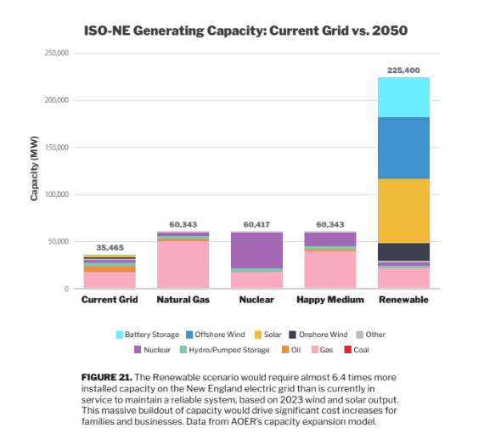
The Renewable Scenario Requires Far More Infrastructure to Meet This New Demand
The Renewable Scenario requires 225 GW of capacity to meet a peak demand of 52.5 GW in our study.
The other scenarios require about 60 GW to provide a healthy reserve margin.
The nuclear and natural gas scenarios need far less capacity because, unlike wind and solar, you can turn them on when you need them.

Slide 12
The Renewable Scenario Requires Far More Infrastructure to Meet This New Demand, Which Increases Costs
This is why the Renewable scenario is so much more expensive than the other scenarios.
The nuclear scenario is expensive because nuclear is much more expensive than natural gas.

Slide 13
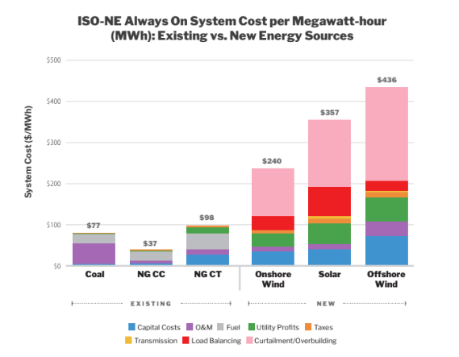
The Levelized Cost of Meeting Electricity Demand with Resources in Each Portfolio
Offshore wind contracts for Vineyard Wind are around $90-$100 per MWh, but that doesn’t tell the whole story.
Newer projects are in the $150 per MWh range.
Meeting demand with largely onshore wind, offshore wind, solar, and batteries requires a massive overbuild of capacity that is only used once in a while.
This reduces the run time of the asset and increases the cost per unit of electricity produced.

Slide 14
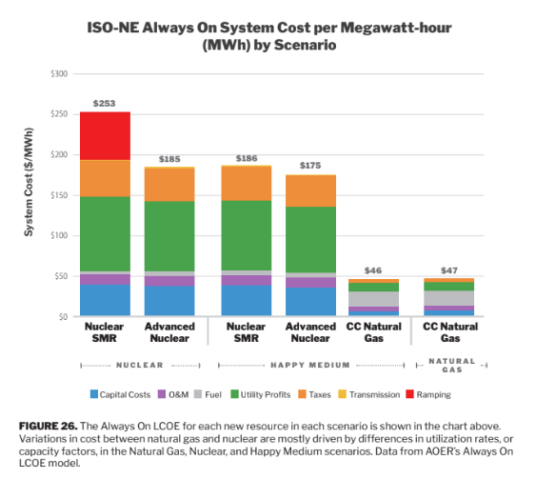
The Levelized Cost of Meeting Electricity Demand with Resources in Each Portfolio
Nuclear and natural gas plants can serve electricity demand for a much lower cost per MWh.
SMRs have a high cost due to ramping, which reduces their power output. This is not an ideal use case for nuclear.
The Happy Medium is more balanced, allowing nuclear to run efficiently and using gas to meet peak demand days.

Slide 15
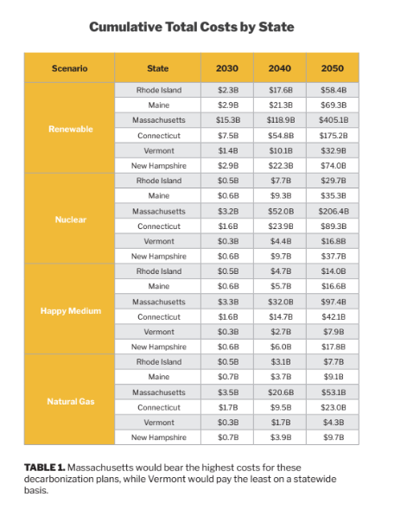
Massachusetts Will Bear the Brunt of the Costs
Massachusetts will pay an additional:
  $405 billion in the Renewable scenario,
  $206 billion in the Nuclear scenario,
  $97.4 billion in the Happy Medium scenario,
  $53.1 billion in the Natural Gas scenario.

Slide 16
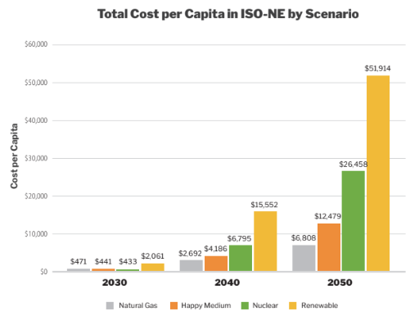
Costs Per Capita
Renewable Scenario per capita costs are massive.
  $2,000 through 2030
  $15,500 through 2040.
  $52,000 through 2050.
All other scenarios are much more affordable.

Slide 17
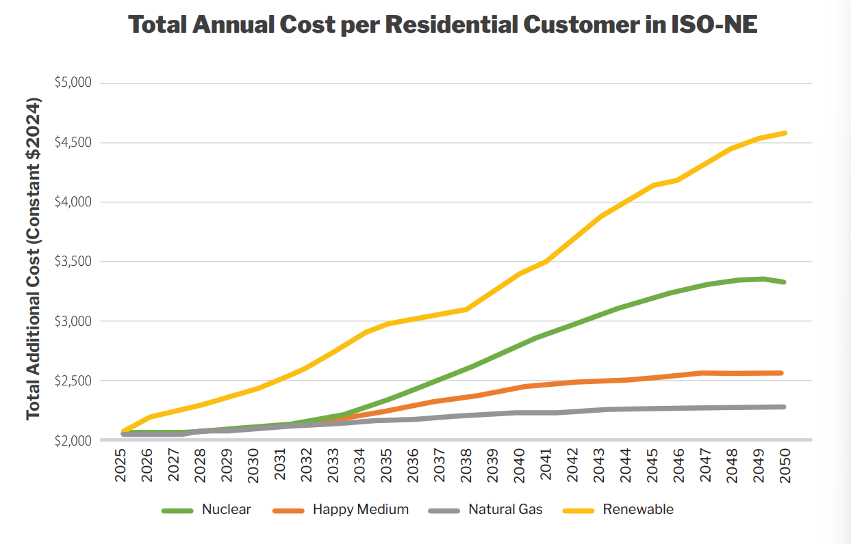
What This Looks Like for Residential Customers
New England already pays some of the highest electricity prices in the country.
The renewable path more than doubles the average family bill, increasing to $4,610 per year by 2050
The Nuclear scenario raises bills to $3,339 per year (and starts to taper as all buildout has been achieved)
$2,569 in the Happy Medium scenario
And $2,302 in the Natural Gas scenario

Slide 18
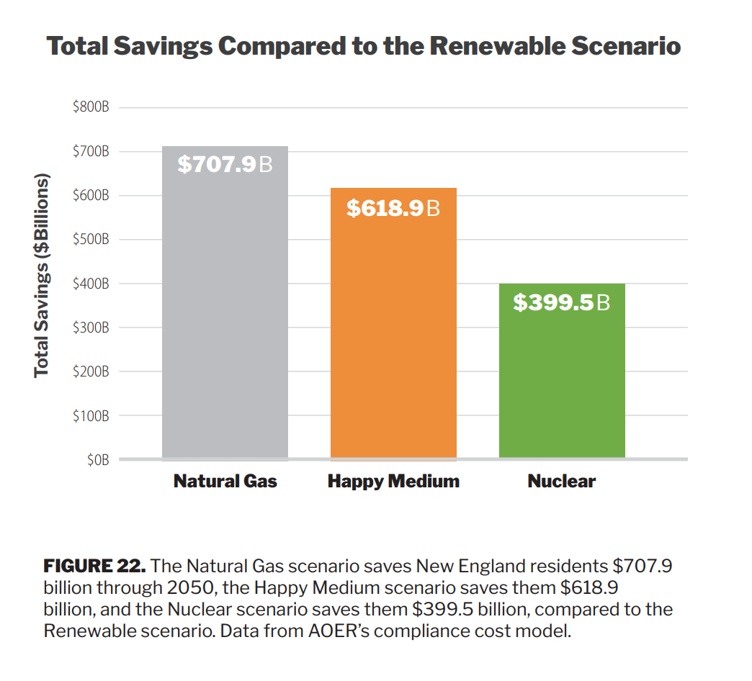
Total Savings Over Renewable Scenario
Choosing any alternative over a system built of wind, solar, and batteries will save billions

Slide 19
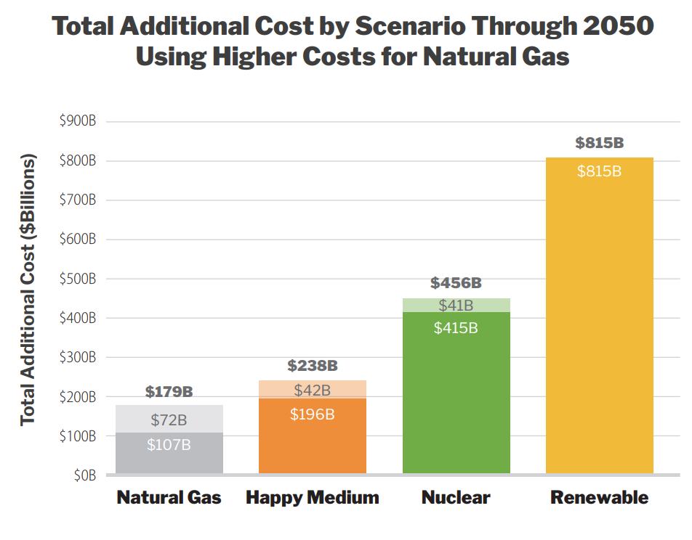
The Gas Advantage Survives a Worst-Case Price Shock
Costs in the Natural Gas scenario and Happy Medium could be affected by prices of natural gas and turbine equipment
Stress testing at $2,500 per kW turbines and gas at $4.90 per MMBtu, up from the $3.00 per MMBtu held flat in the base case.
Natural Gas still ends up less expensive, at $179 billion versus $107 billion in the base case, and far below the $815 billion renewable path.

Slide 20
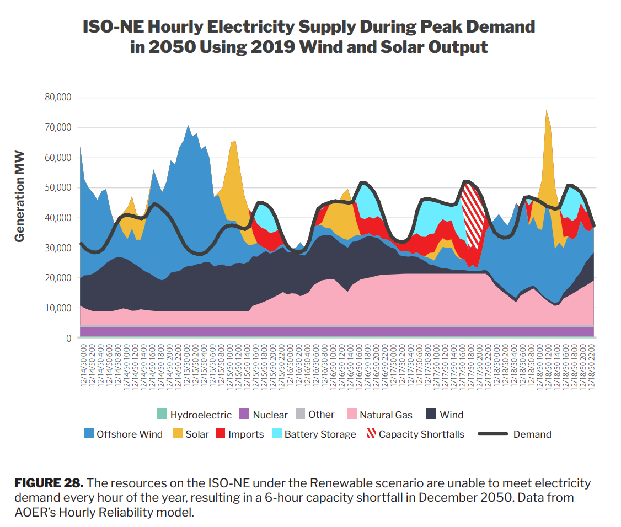
Renewable Scenario is Unreliable
Even with all the extra capacity, the Renewable scenario would be unable to keep the lights on under certain historical wind and solar output scenarios.
This would result in a six-hour blackout that accounts for about 40 percent of the total demand at the time.

Slide 21
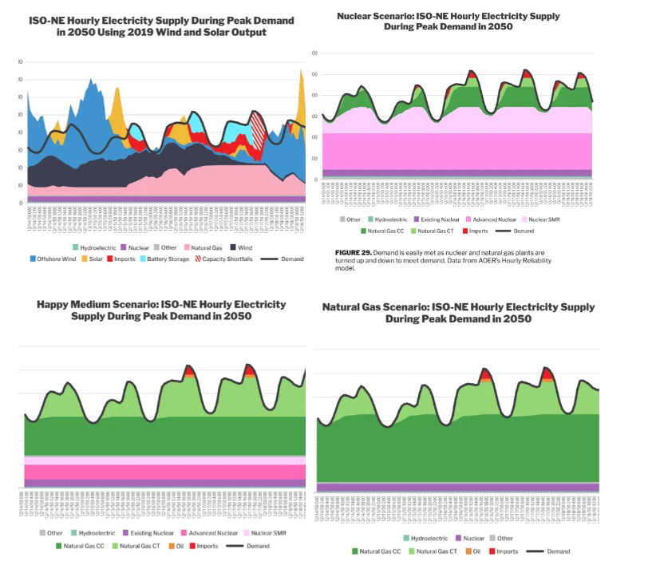

Slide 22
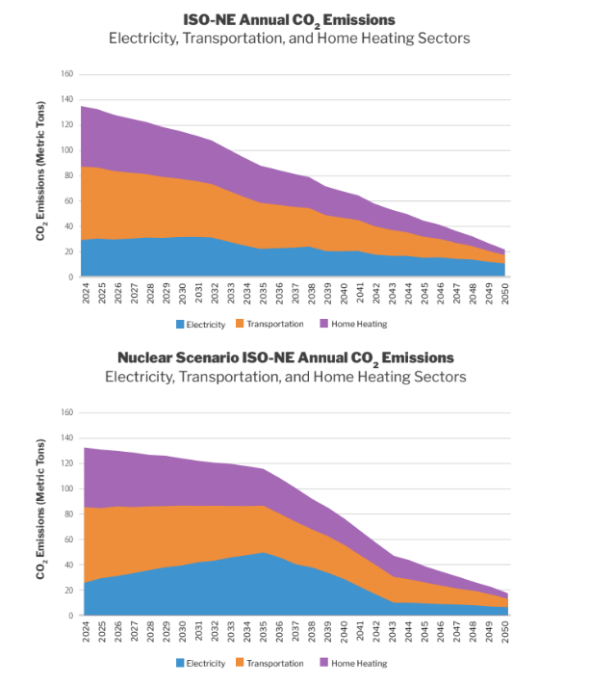
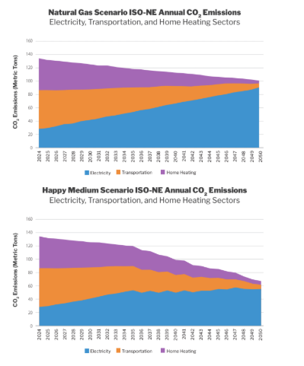
Emissions

Slide 23
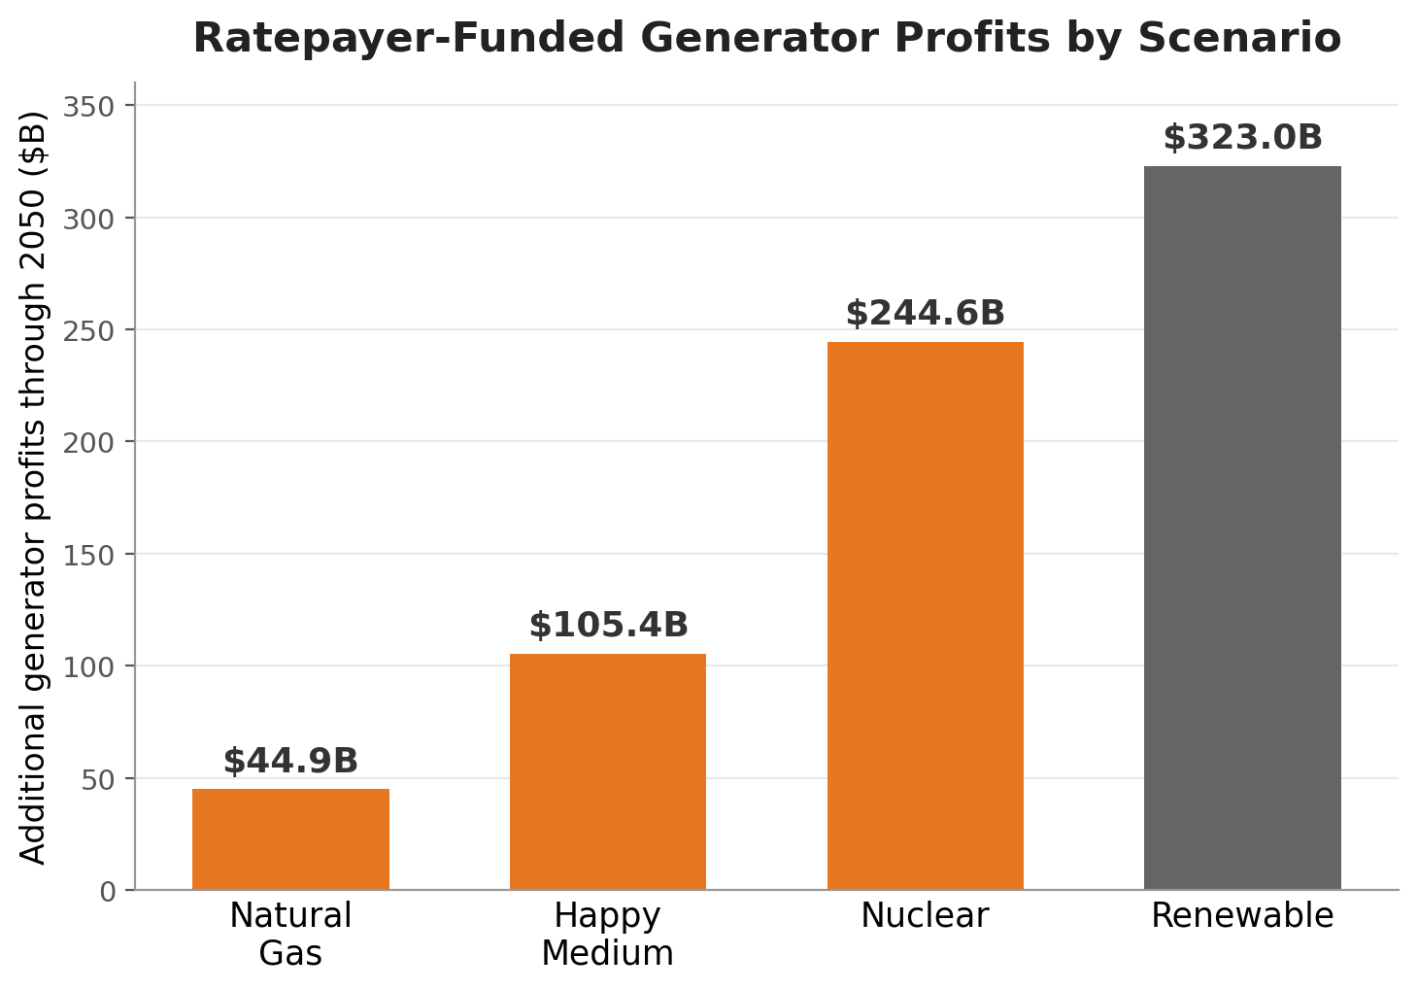
Ratepayer-Funded Returns Scale With Capital Deployed
ISO-NE generators are not monopolies earning a guaranteed return. Some are paid through ratepayer-funded, long-term contracts for large-scale, carbon-free energy.
We assume across the region 7.05 percent returns + recovering upfront capital
The Renewable scenario loads $323 billion in generator profits onto ratepayers through 2050.
The Natural Gas scenario carries just $44.9 billion, a $278 billion difference in investor returns alone.
Public power adds no shareholder markup of its own.
Always On report, Section IV. Additional generator profits, 7.05% return on investment.
A $278 billion swing in investor returns, funded by ratepayers.

Slide 24
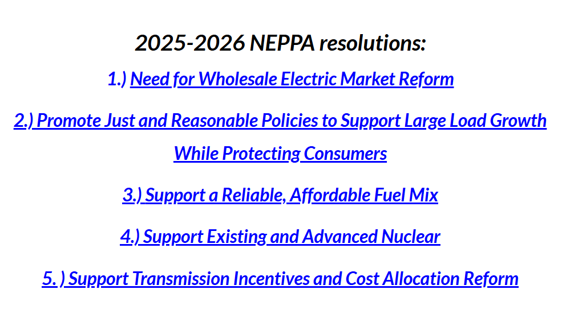
Your Resolutions

Slide 25
Questions, Comments?
Check out our work at: www.AOEnergy.org
Contact me for modeling studies, consulting or speaking opportunities: sarah@aoenergy.org
Full report: https://www.aoenergy.org/work/total-system-cost-wind-and-solar-new-england/

