Slide 1
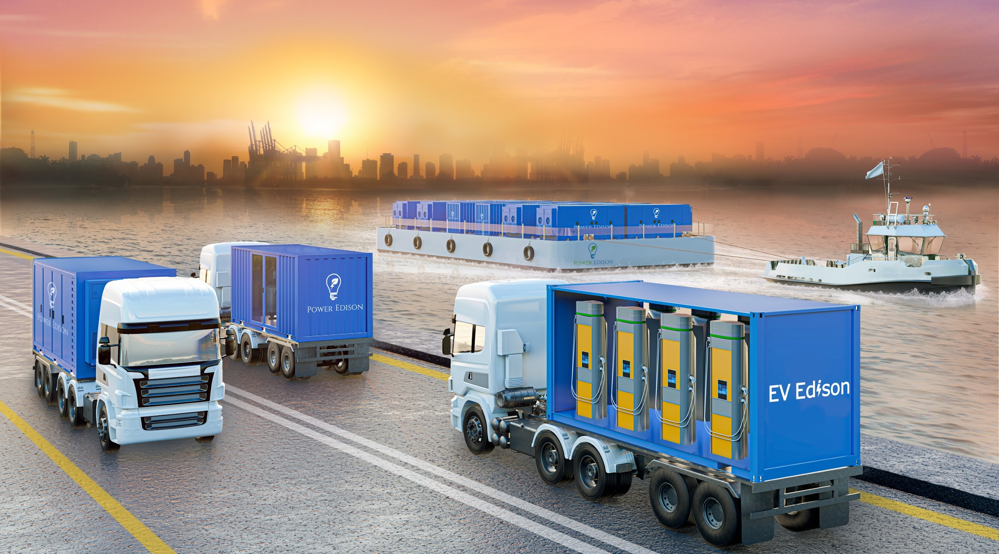


Mobile Battery Energy Storage
Prepared for:
Dr. Shihab Kuran , CEO
Andy McMahon, Advisory Board
Proprietary & Confidential

Slide 2



Executive Summary
+67%
~80%
~4 yrs
higher New England residential rates than the U.S. average
of U.S. power outages are weather-driven
for new grid capacity to clear interconnection
Affordability
Resilience
Unmatched Flexibility
Capacity and transmission charge reductions
Deploy utility-grade storage to strengthen grid reliability and maintain service continuity during outages
Relocate assets as needs evolve — no stranded infrastructure, no long-term commitment to a single location
Power Edison partners with public power utilities to put downward pressure on customer bills — deploying mobile and stationary storage that turns rising capacity, transmission, and infrastructure costs into lasting community savings.
Sources: U.S. EIA residential rates (May 2025); Climate Central; Enverus 2025 Interconnection Queue Outlook (ISO-NE).
Power Edison Proprietary & Confidential
2
Notes:
Anchor the talk. Affordability is the public-power mandate. Three pillars: Affordability, Resilience, Unmatched Flexibility. Seed the questions the rest answers.

Slide 3




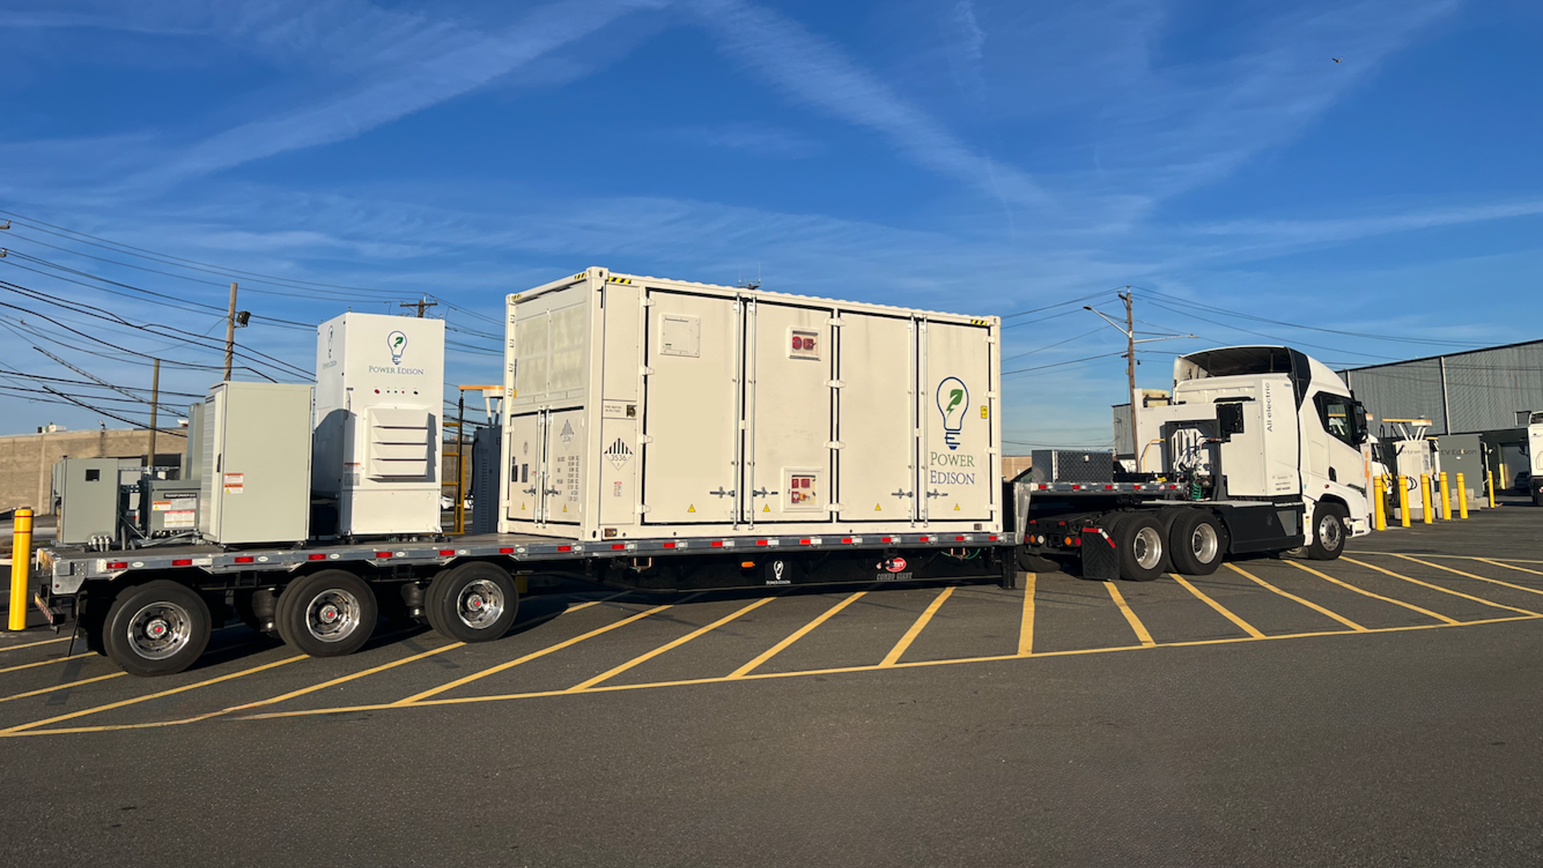













Power Edison at a Glance
The leader in utility-grade mobile battery energy storage.
World’s Largest
40+
1 GWh+
mobile battery energy storage system
active multi-MW utility engagements
project pipeline
A team drawn from the industry’s leading institutions
Power Edison Proprietary & Confidential
3
Notes:
Credibility. Logos carry it — utilities deployed with, and the team's pedigree (NRG, SunEdison, Petra Solar, BlackRock, Schneider). "Largest mobile battery system in the world" is company language; deliver it plainly.

Slide 4





Why Battery Energy Storage?
Over 20 operational benefits including, but not limited to:
Peak Shaving & Demand Reduction
Grid Resilience & Reliability
Clean Energy Integration
Reduce wholesale capacity costs and transmission charges
Instant backup power and black start capability for critical infrastructure
Store excess renewable generation from on-site solar for dispatch during peak periods; advance clean energy portfolio goals
T&D Infrastructure Deferral
Wholesale Market
Participation
Speed to Power
Deploy storage at constrained sites to defer costly upgrades
Participate in ISO/RTO capacity, energy, and ancillary service markets to further ease congestion in service area
Deploy grid capacity in weeks versus years for traditional infrastructure
Power Edison Proprietary & Confidential
4

Slide 5



Why mobile? One asset, always at work.
A fixed installation earns its value at one site. A mobile asset follows the constraint.
01
02
03
→
→
Deploy
Redeploy
Repeat
Place the unit against today's binding constraint — a congested feeder, a coincident peak, or a storm restoration.
When that constraint clears, relocate to the next — seasonally, or across the service territory.
One capital base captures value at site after site, peak after peak — over a 20-year life and is never a stranded asset.
The result:
Affordability — value captured repeatedly from a single investment — and Resilience — utility grade power and energy density that can be sent wherever and whenever the grid needs it most.
Power Edison Proprietary & Confidential
5
Notes:
The differentiator. Deploy, redeploy, repeat. One capital base, many peaks and sites. Contrast stationary: value earned once, stranded when the host feeder is upgraded.

Slide 6
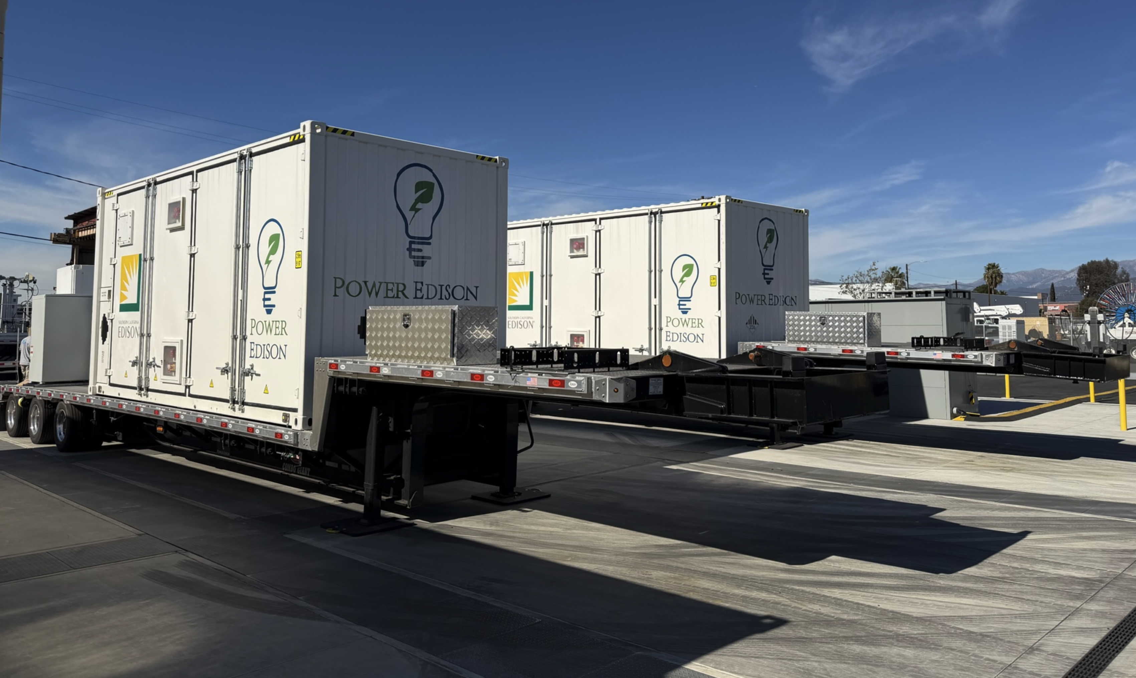
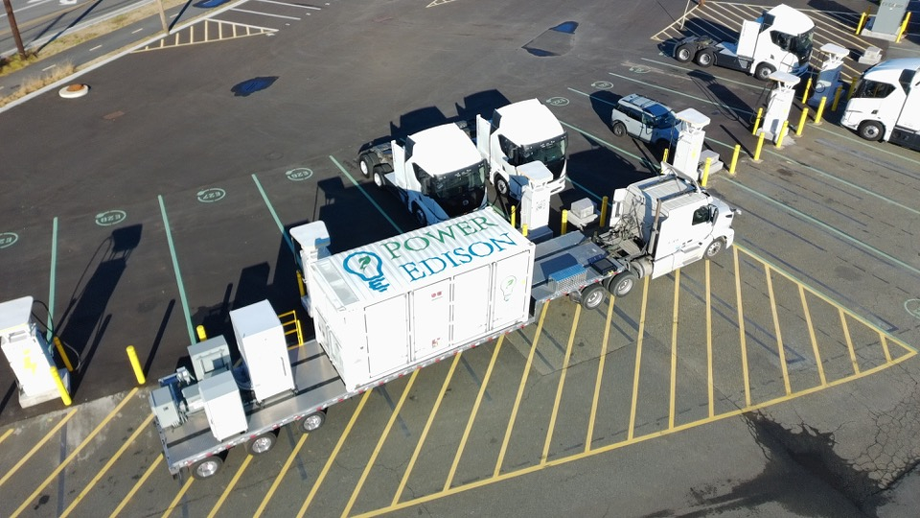

TerraCharge™ Prime: Single Trailer Deployment
Mobile BESS solutions custom fitted on one trailer for various deployment scenarios
Power Edison Proprietary & Confidential
6

Slide 7
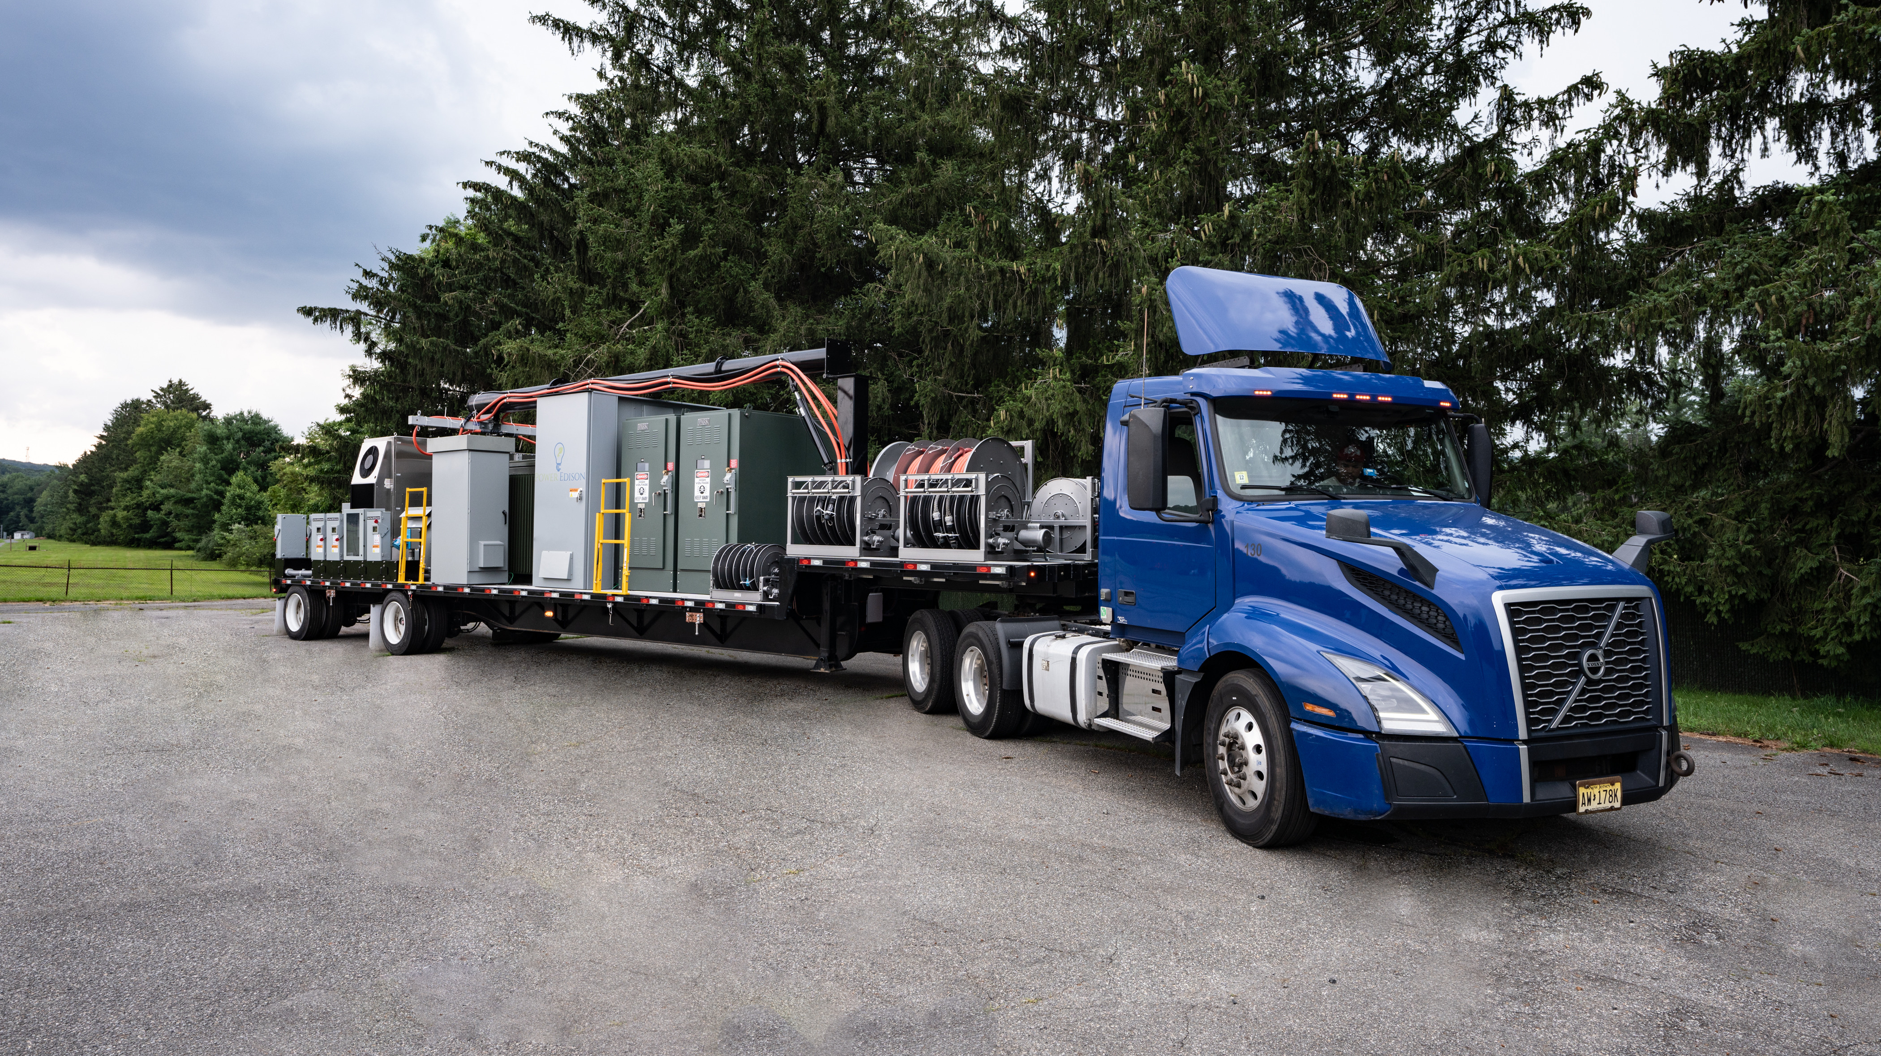
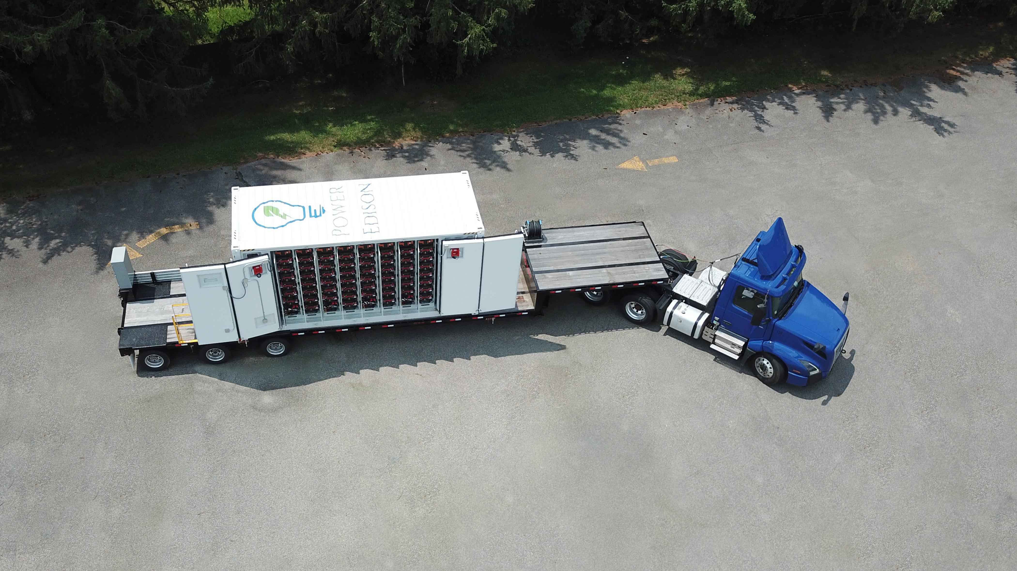
TerraCharge™ Plus: Multi-Trailer System
Mobile substation can be paired with multiple mobile battery trailers for scalable deployments
Power Edison Proprietary & Confidential
7

Slide 8
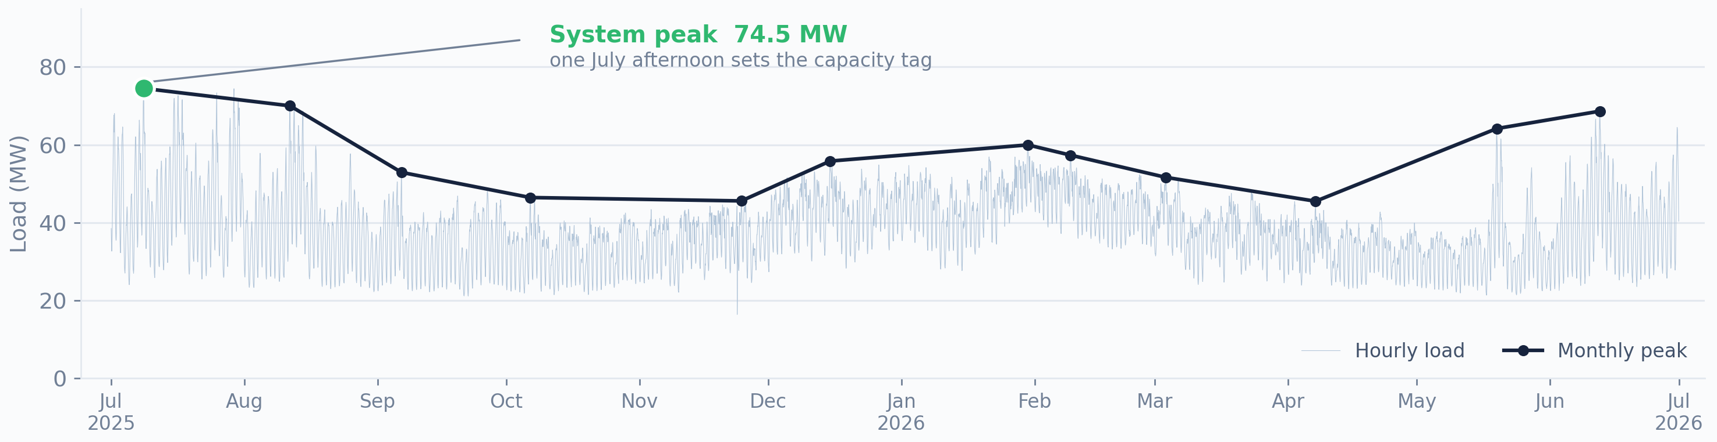

A New England member utility’s last 12 months
Representative load profile based on hourly settlement data.
Average demand sits near 38 MW.
Savings of $200-300/ kW-yr shaving the peak.
Source: ISO New England real-time load settlement data for a NEPPA-region member utility, July 2025 – June 2026 (8,760 hourly intervals), provided via Energy New England. Utility de-identified.
Power Edison Proprietary & Confidential
8
Notes:
Real member data, de-identified. Ties slide 9 from illustration to evidence. Note the dual peak: a sharp summer peak that sets the capacity tag, and a broad winter shoulder. The navy line is what the utility is actually billed on — twelve monthly peaks, plus the single highest hour of the year.

Slide 9



Resilience and Mutual Aid
Storms and outages are when community-owned utilities come together — public power already shares crews and equipment across the six New England states.
A mobile battery is resilience.
Storm response & black start
Through the NEPPA Mutual Aid Network, members already move crews and equipment to points of need. A Power Edison unit is dispatchable the same way — backup and black-start capability while crews rebuild, then redeployed.
Instant backup keeps critical loads energized while crews restore circuits.
Critical community facilities
Water, wastewater, shelters, and emergency services stay powered through the outage.
Shared across the network
Roll unit to the member community that needs it most.
Mobile storage extends public power’s mutual-aid model to dispatchable energy — shared resilience for New England’s community-owned utilities.
Power Edison Proprietary & Confidential
9
Notes:
Dedicated resilience & mutual aid slide (replaces the redundant 'many missions' grid). Anchored in NEPPA's own Mutual Aid Network — members already share crews/equipment across six states; a mobile battery is the next shareable resource. Mutual aid is a cornerstone of public-power culture; this is where the room feels ownership.

Slide 10
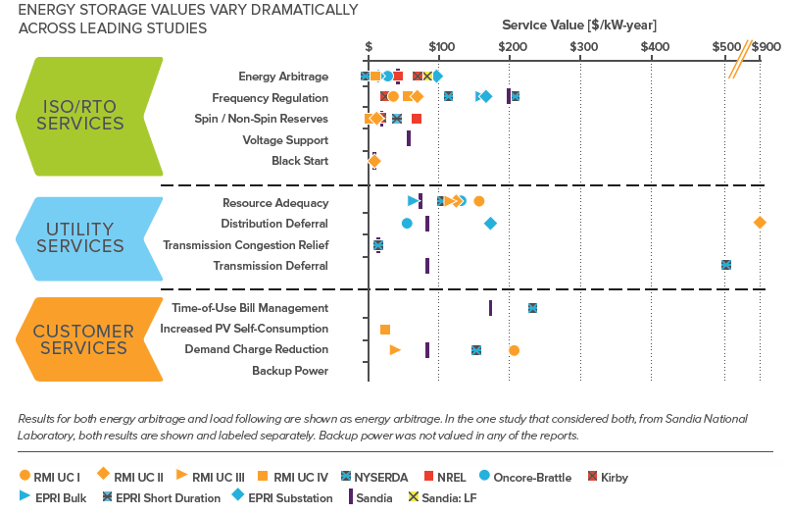
The Value of T&D Deferral
Storage deployed for distribution deferral can deliver utility-specific value in the hundreds of dollars per kW-year
Source: Rocky Mountain Institute, “The Economics of Battery Energy Storage” (2015) — distribution deferral analysis. Industry-standard reference for grid-asset value stacking.
Power Edison Proprietary & Confidential
10

Slide 11
Benefit-Cost Analysis Comparison
Once the host feeder is upgraded, stationary BESS loses its deferral value — mobile redeploys and captures it again, repeatedly over a 20-year life
STATIONARY BESS
MOBILE BESS
VALUE STREAMS
At one substation, one peak
Redeployed across locations over 20-year life
T&D Deferral (Winter)
Rocky Mountain Institute — $50–$900/kW-yr
Other (Volt/VAR, frequency reg)
T&D Deferral (Summer)
Backup Power, 2nd -nth Location
Same RMI methodology; second seasonal peak
Backup Power, 1st Location
Accelerated Load Energization
Load Energization, 2nd -nth Location
DOE / NREL / Calibrant–Aligned (2024–2025) — $200–$1,500+/kW-yr
Load Energization, 1st Location
Backup Power / Resilience
T&D Deferral — Summer, 3rd-nth Location
LBNL ICE Calculator 2.0 (2025) — $50–$1,500+/kW-yr
T&D Deferral — Summer, 2nd Location
T&D Deferral — Summer, 1st Location
Other (Volt/VAR, frequency reg)
T&D Deferral — Winter, 3rd-nth Location
Sandia DOE ESHB — modest per-site; multi-site stacking is the point
T&D Deferral (one location, one cycle)
1.0
T&D Deferral — Winter, 2nd Location
Lighter shade = redeployment to a new location (2nd, nth)
1.0
T&D Deferral — Winter, 1st Location
Cost
Benefit
Cost
Benefit
Benefit/Cost = 0.67x
Benefit/Cost = 7.1x
Stranded after host-feeder upgrade
~10x stationary — value stacked across redeployments
B/C ratios are representative; actual site values vary by feeder condition, load growth, outage frequency, and customer mix.
Power Edison Proprietary & Confidential
11

Slide 12
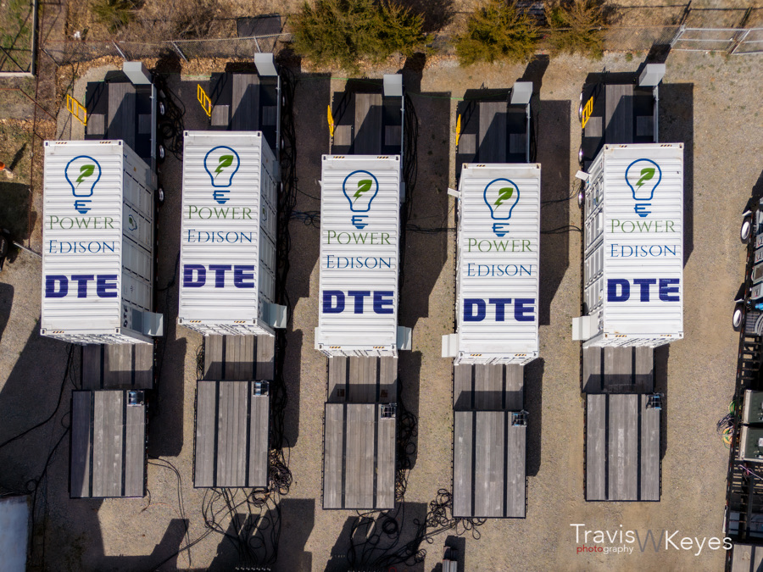



Utility-grade safety
Engineered to the standards utilities require.
Layered fire safety
NFPA-compliant detection and suppression in every battery container, reachable from ground level. Qualified, non-propagating LFP chemistry keeps a single-cell event from cascading.
Monitoring & protection
Battery management monitors every cell, module, and rack. Lockable disconnects at module and rack levels; cyber-hardened EMS with utility SCADA integration.
Transportation-hardened
Conduit-routed wiring with no exposed runs; air-ride suspension and vibration dampening. Onboard vibration, acceleration, and GPS monitoring verify system health before arrival.
CERTIFIED & COMPLIANT TO UTILITY STANDARDS
UL 9540
UL 9540A
tested
UL 1973
UL 1741
Mobility is its own safeguard
Relocate systems ahead of flooding, wildfire, or severe weather events
NFPA 855
IEEE 1547
UN 38.3
IEC 62619
Full certification and compliance list on the TerraCharge™ Prime specification sheet.
Power Edison Proprietary & Confidential
12
Notes:
Dedicated safety. Non-propagating LFP, NFPA fire suppression at ground level, cell-level BMS, transport hardening. Certifications on the right. Where a skeptical operations audience leans in.

Slide 13

Thank you.
For full specification sheets — and to shape configurations to fit your community’s needs — reach out to info@poweredison.com
908-312-1242

